Slide 1
Progress Update
1/8/2021
David Chen

Slide 2
Bar Plots of Fold Change between Fraction and Top 2.5% Fraction

Slide 3
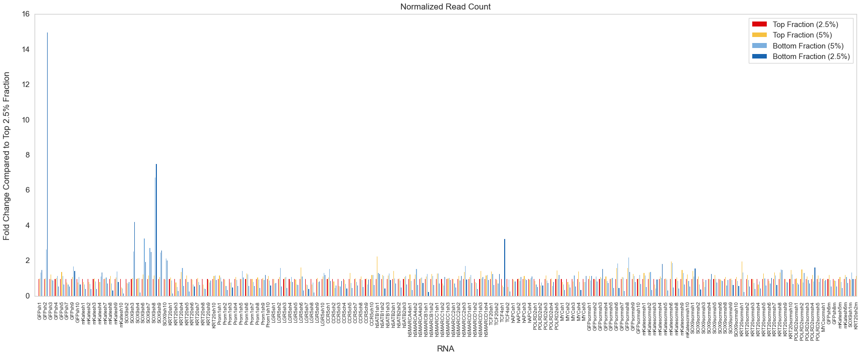
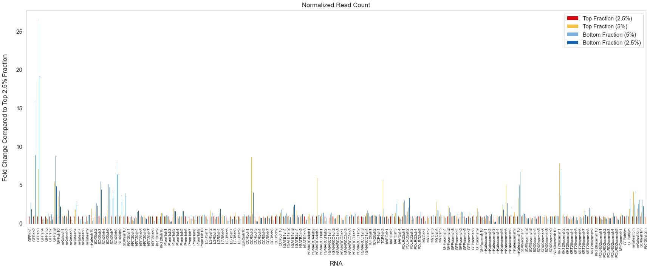
Primer 1
Day 3
Day 7

Slide 4
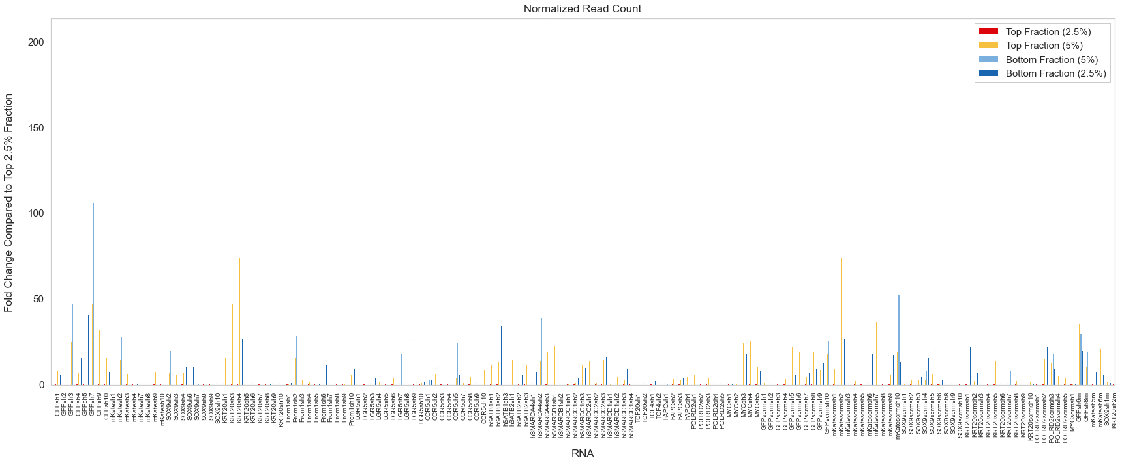
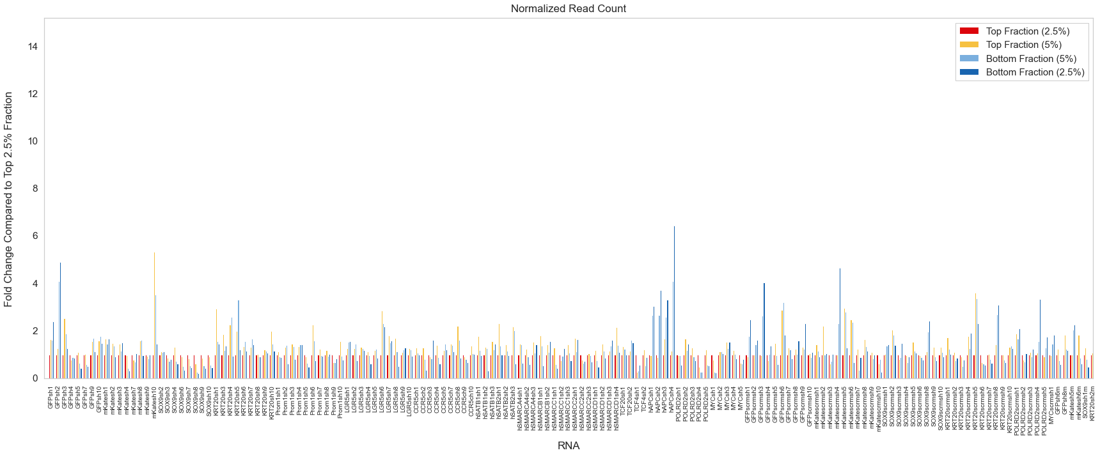
Primer 2
Day 3
Day 7

Slide 5
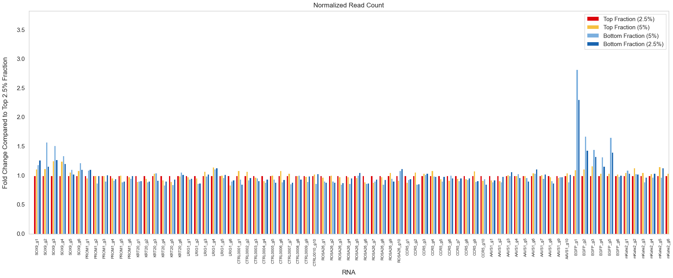
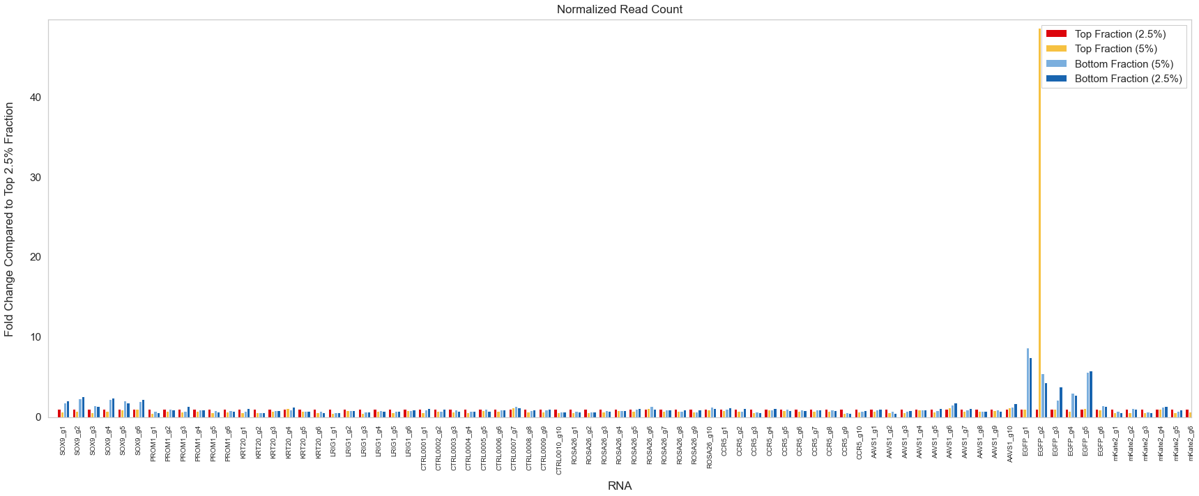
Primer 3
Day 3
Day 7

Slide 6
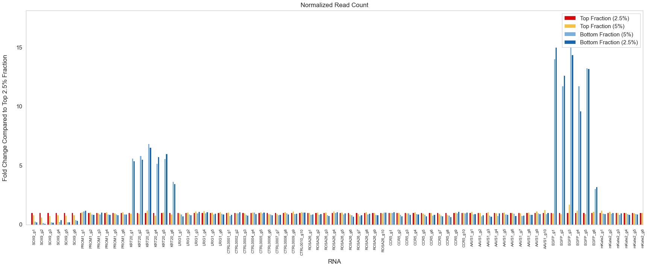
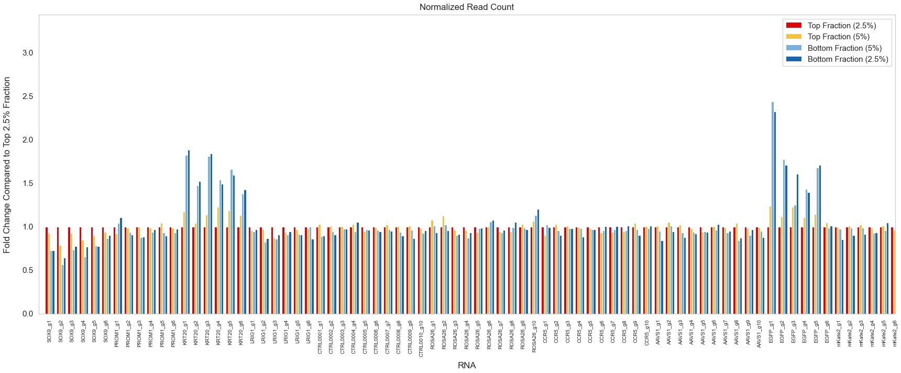
Primer 4
Day 3
Day 7

Slide 7
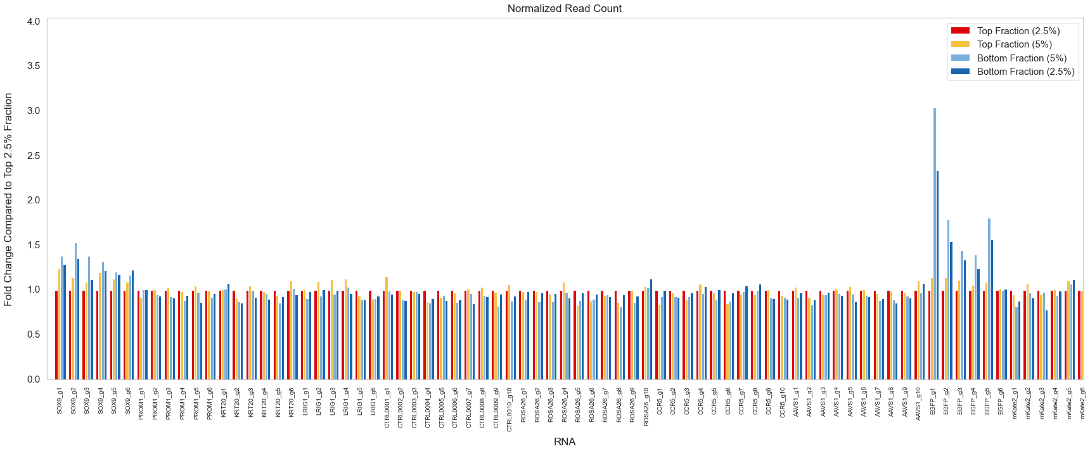
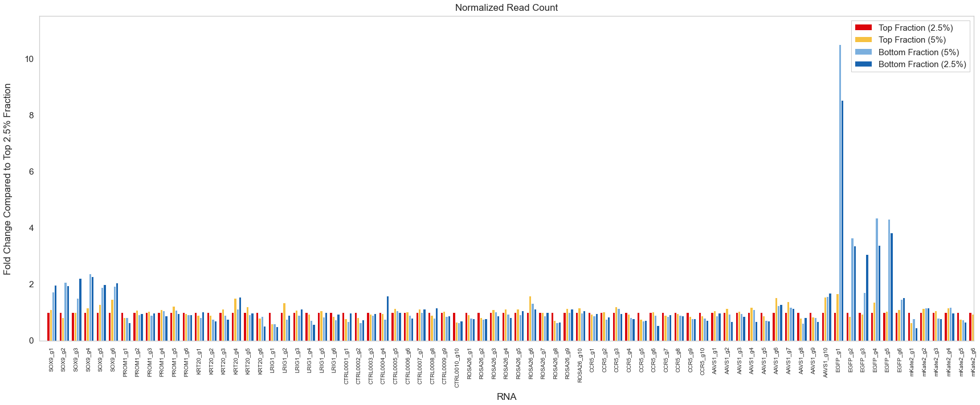
Primer 5
Day 3
Day 7

Slide 8
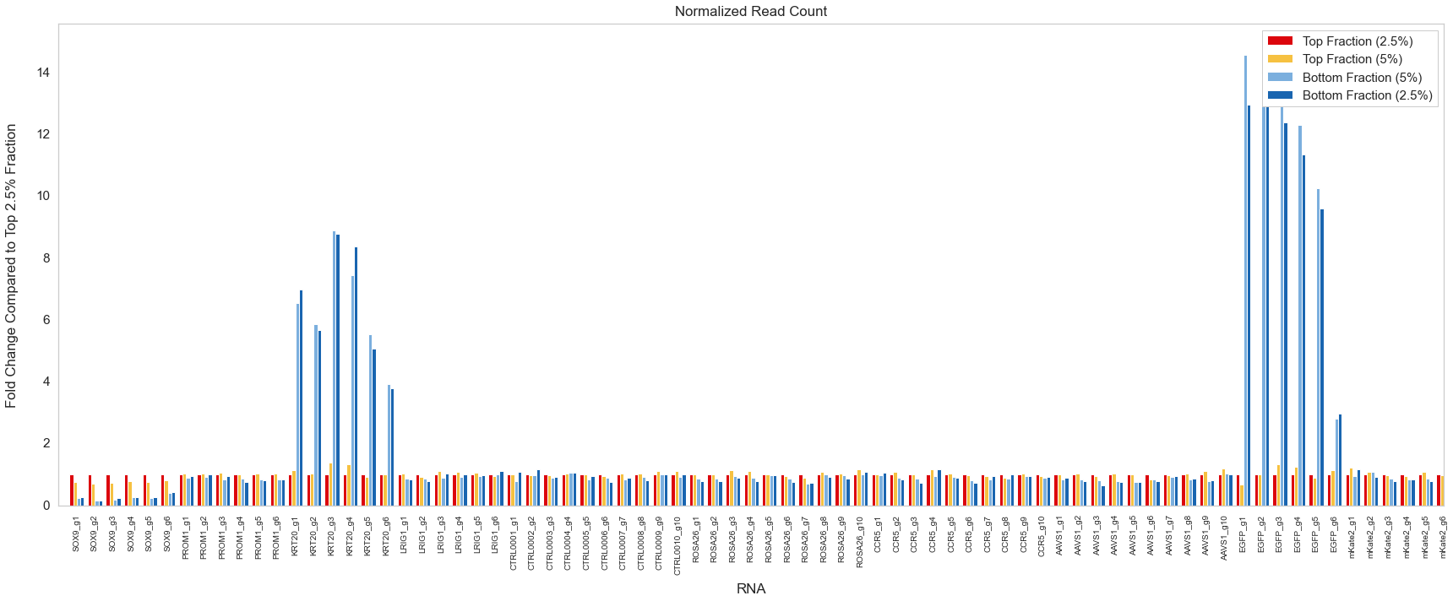
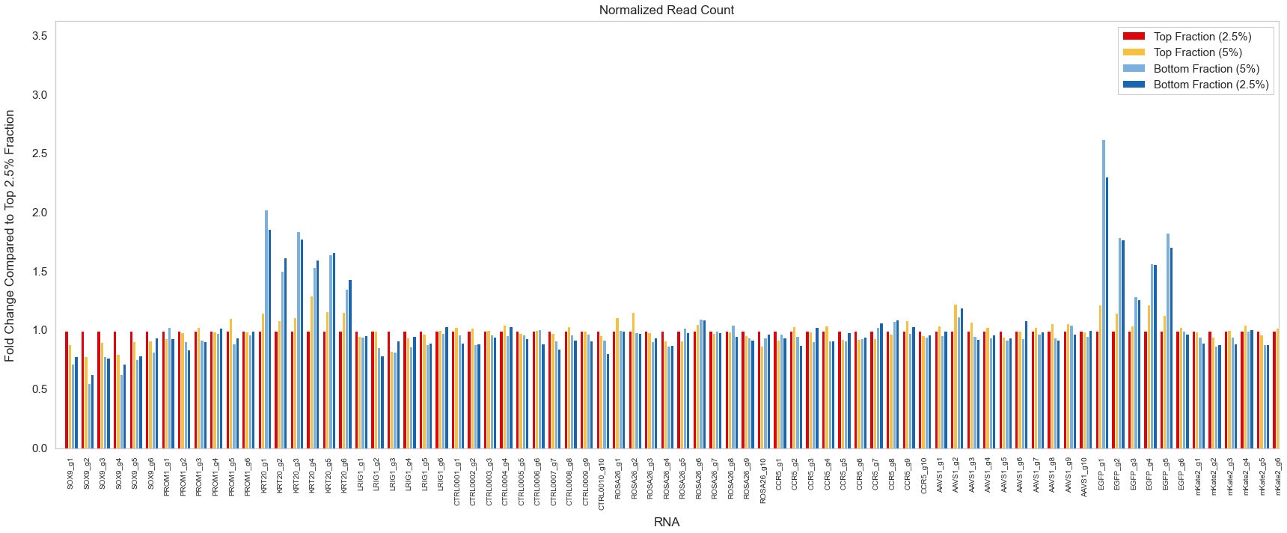
Primer 6
Day 3
Day 7

Slide 9
Summary Bar Plots and Box Plots of Fold Change between Fraction and Top 2.5% Fraction

Slide 10
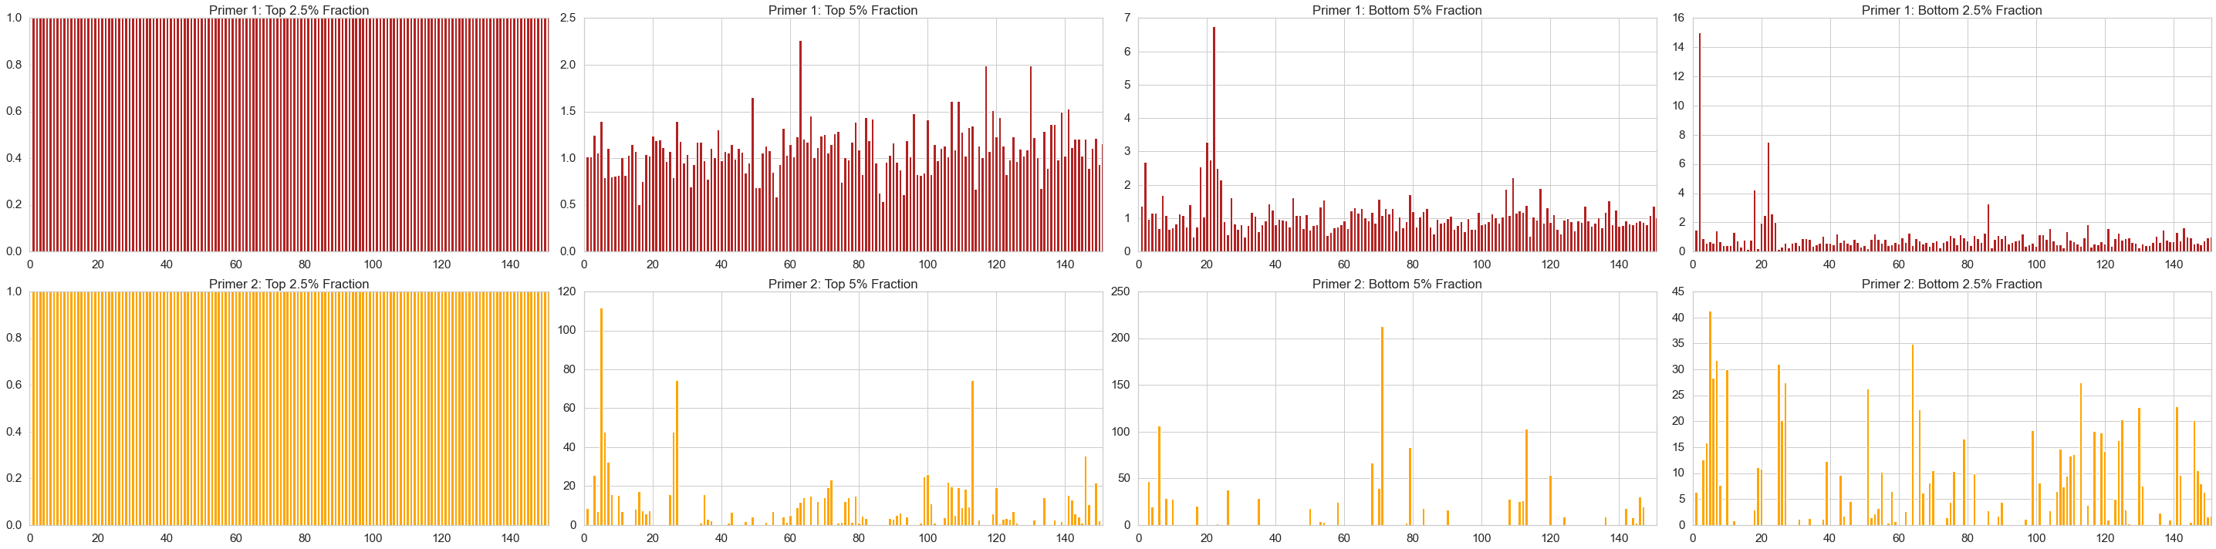
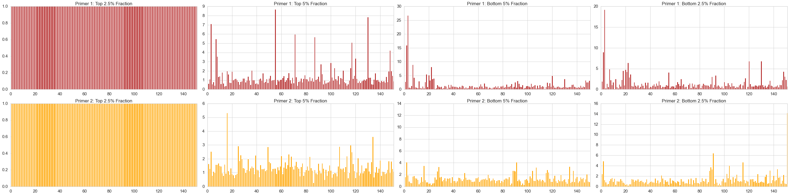
shRNA
Top 2.5%
Top 5%
Bottom 5%
Bottom 2.5%
Primer 1: Day 3
Primer 2: Day 3
Primer 1: Day 7
Primer 2: Day 7

Slide 11
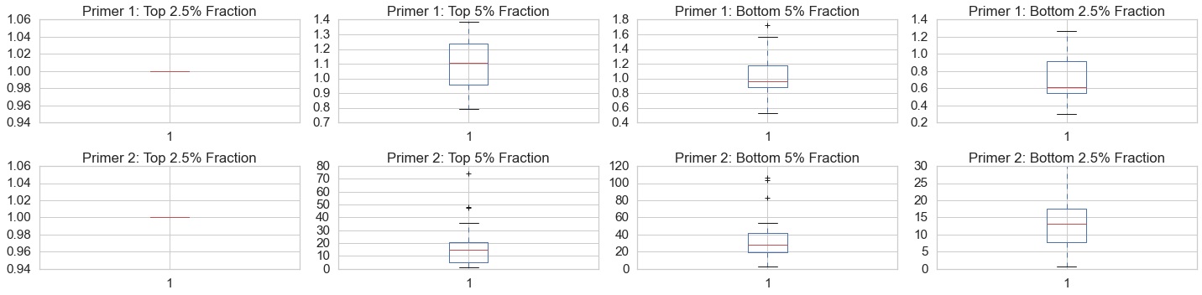
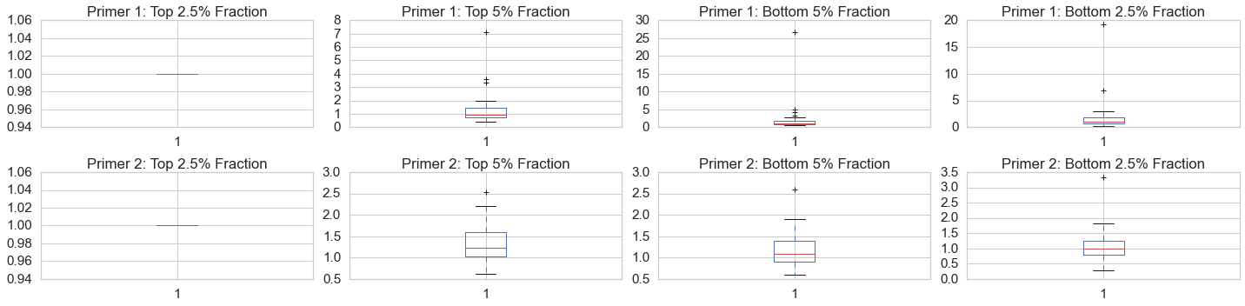
shRNA
Top 2.5%
Top 5%
Bottom 5%
Bottom 2.5%
Primer 1: Day 3
Primer 2: Day 3
Primer 1: Day 7
Primer 1: Day 7

Slide 12
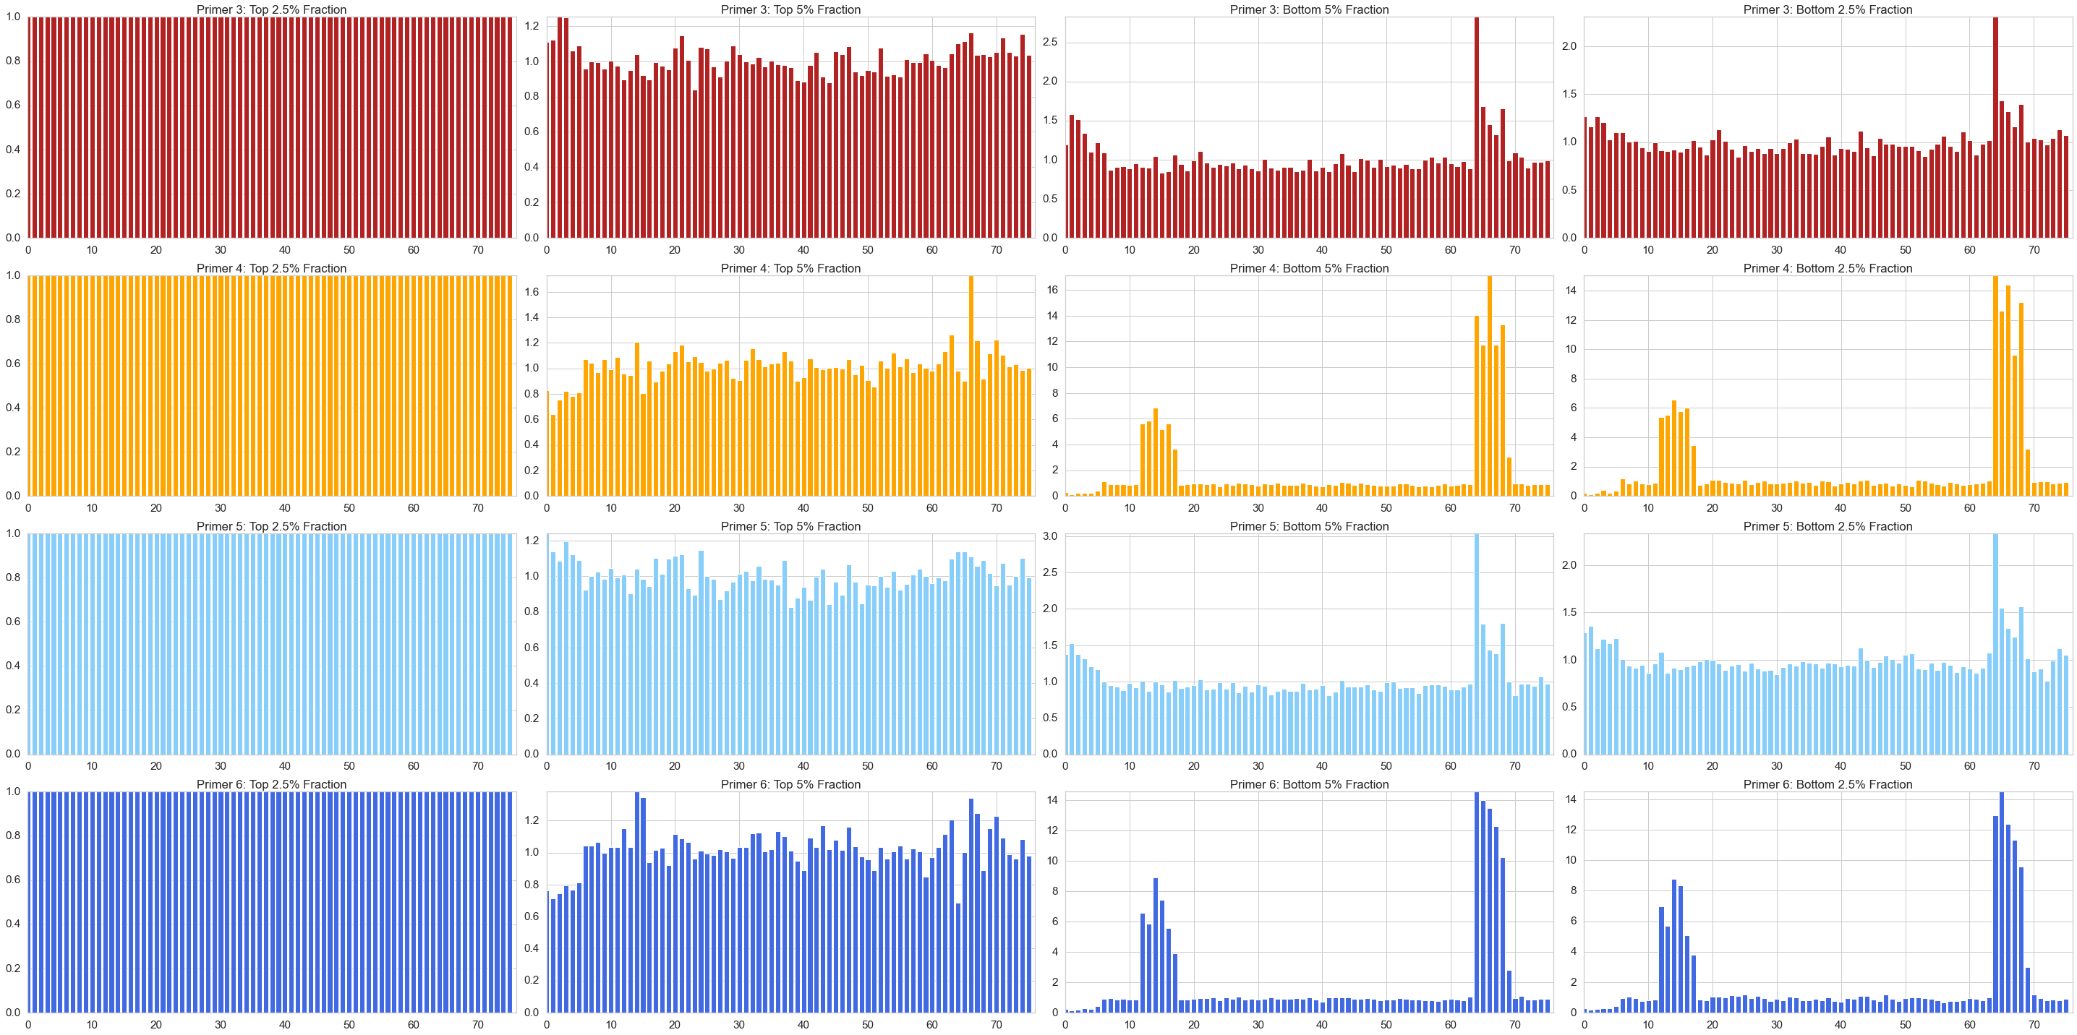
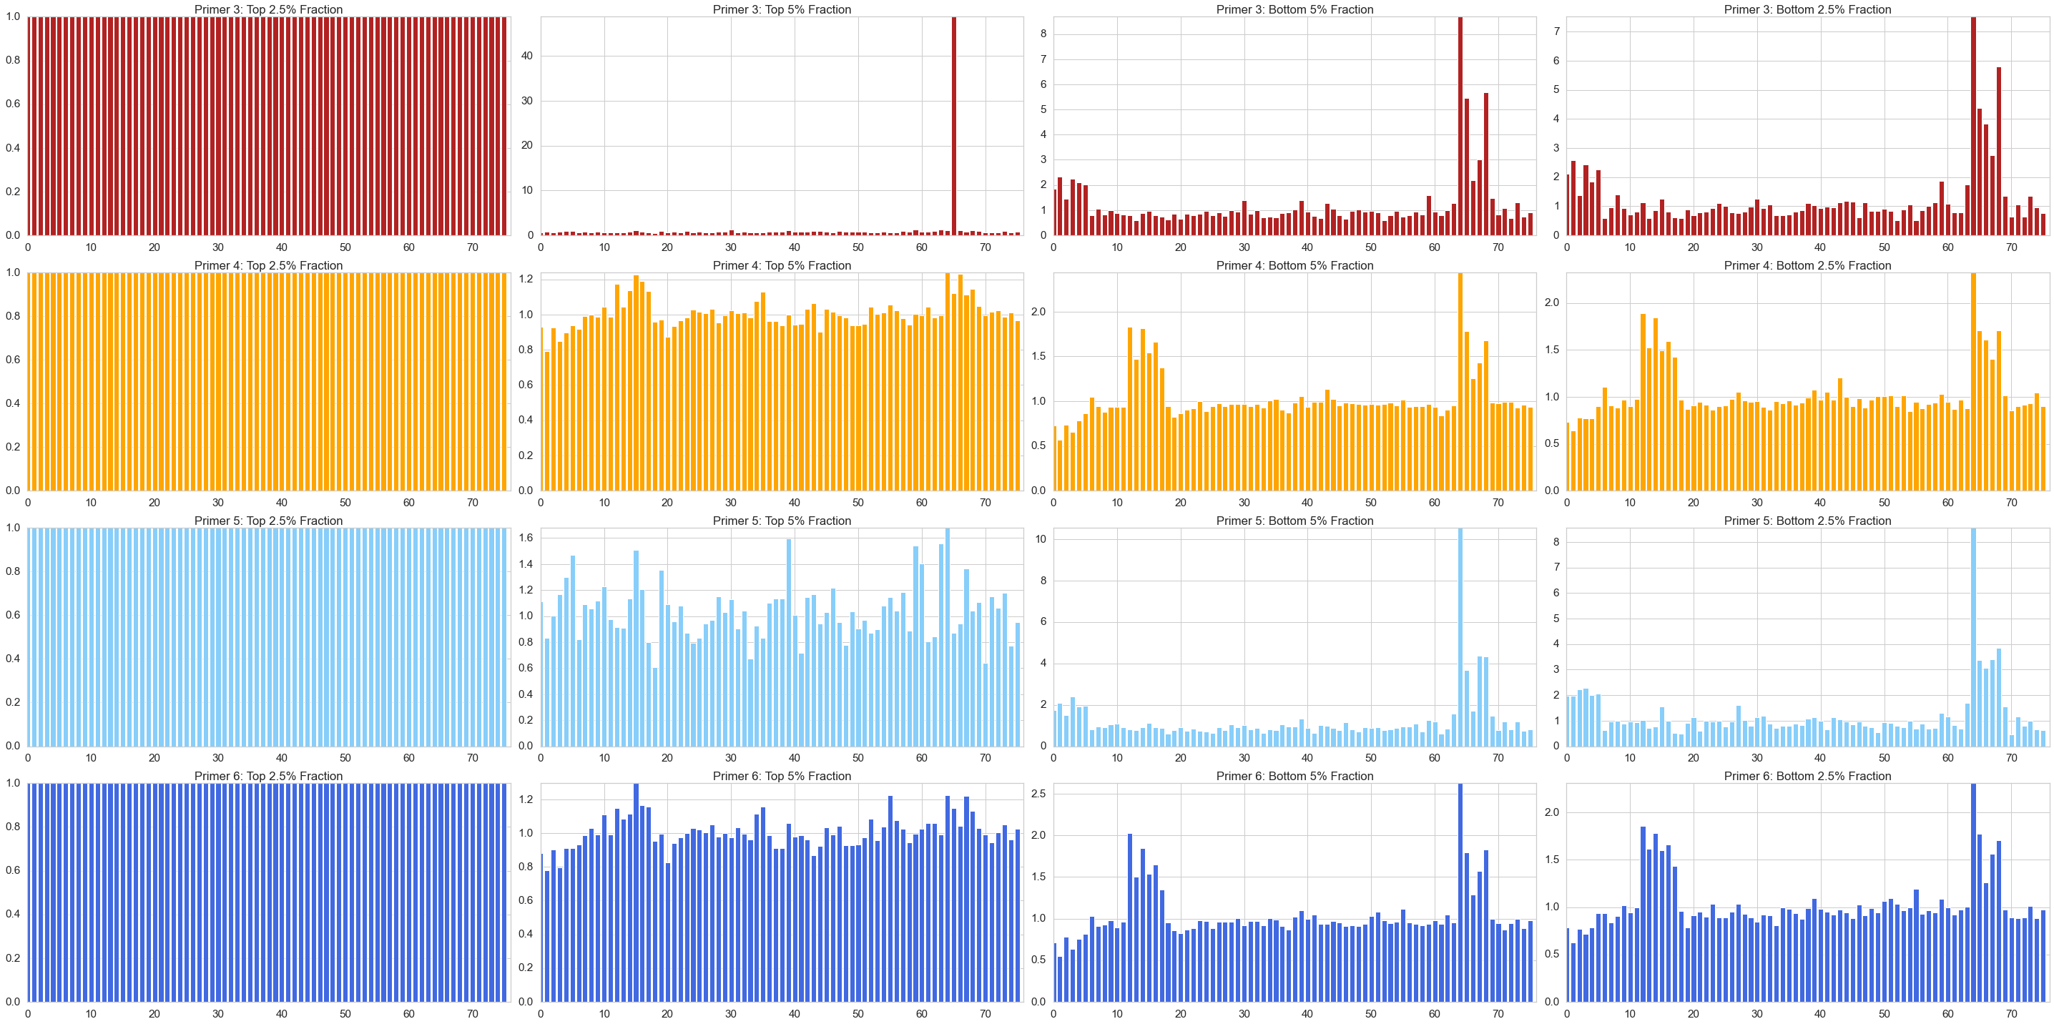
Top 2.5%
Top 5%
Bottom 5%
Bottom 2.5%
gRNA
Primer 3: Day 3
Primer 4: Day 3
Primer 5: Day 3
Primer 6: Day 3
Primer 3: Day 7
Primer 4: Day 7
Primer 5: Day 7
Primer 6: Day 7

Slide 13
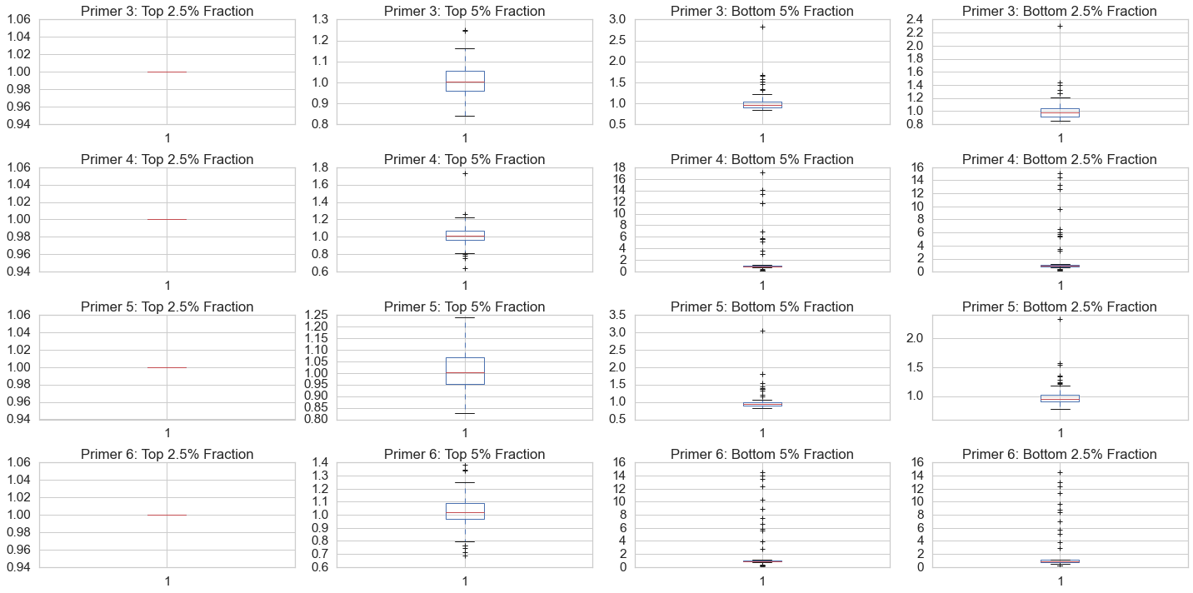
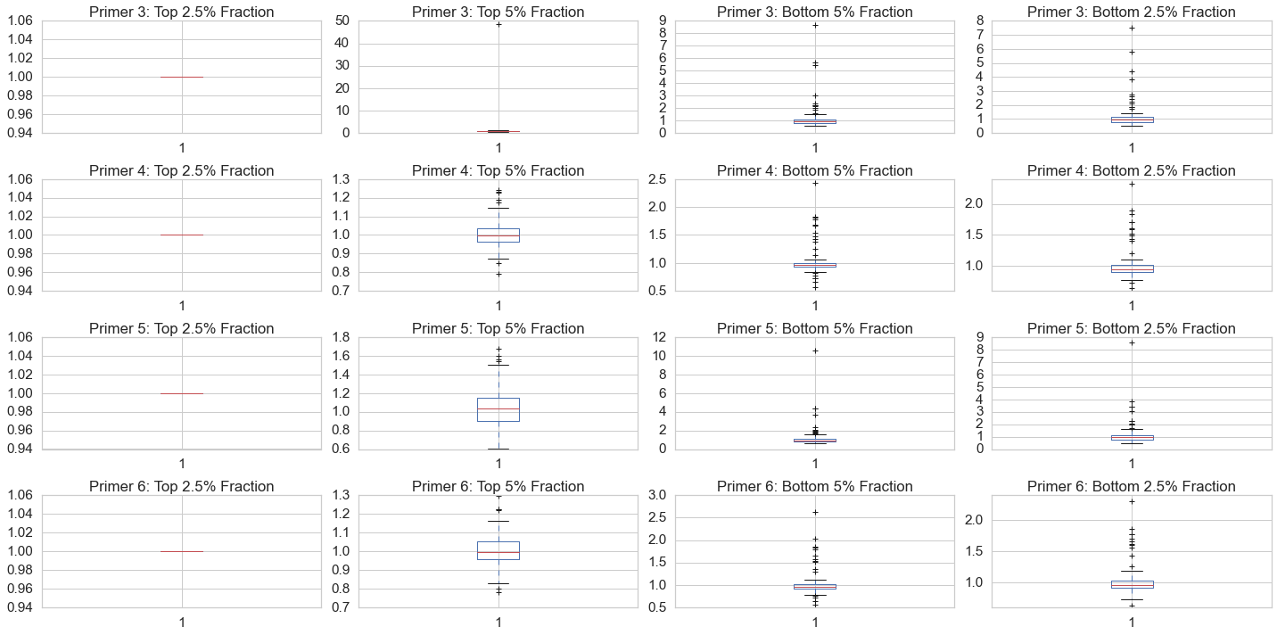
Top 2.5%
Top 5%
Bottom 5%
Bottom 2.5%
gRNA
Primer 3: Day 3
Primer 4: Day 3
Primer 5: Day 3
Primer 6: Day 3
Primer 3: Day 7
Primer 4: Day 7
Primer 5: Day 7
Primer 6: Day 7

Slide 14
Heatmap of Fold Change between Fraction and Top 2.5% Fraction

Slide 15
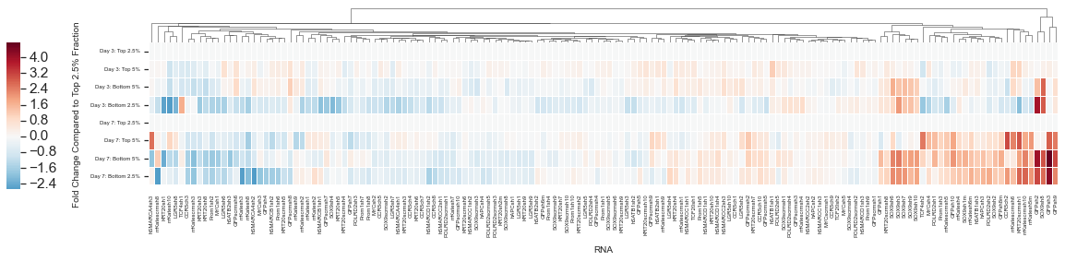
Primer 1
Day 3: Top 2.5%
Day 3: Top 5%
Day 3: Bottom 5%
Day 3: Bottom 2.5%
Day 7: Top 2.5%
Day 7: Top 5%
Day 7: Bottom 5%
Day 7: Bottom 2.5%
Day 3
Day 7
0 features dropped

Slide 16
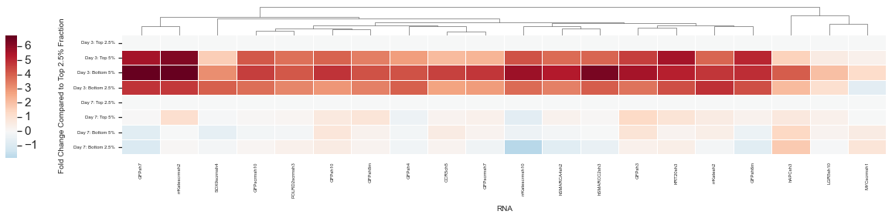
Primer 2
Day 3: Top 2.5%
Day 3: Top 5%
Day 3: Bottom 5%
Day 3: Bottom 2.5%
Day 7: Top 2.5%
Day 7: Top 5%
Day 7: Bottom 5%
Day 7: Bottom 2.5%
Day 3
Day 7
131 RNA excluded since any RNA with zero read counts cannot be log scaled

Slide 17
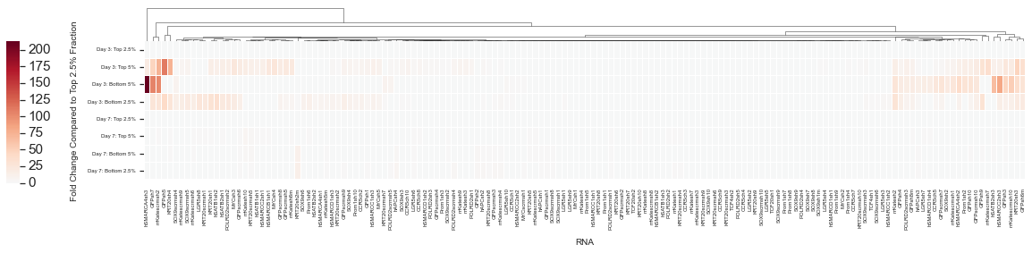
Primer 2
Day 3: Top 2.5%
Day 3: Top 5%
Day 3: Bottom 5%
Day 3: Bottom 2.5%
Day 7: Top 2.5%
Day 7: Top 5%
Day 7: Bottom 5%
Day 7: Bottom 2.5%
Day 3
Day 7
Not Log scaled and no RNA excluded

Slide 18
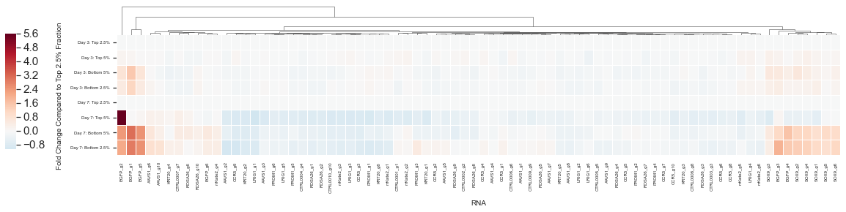
Primer 3
Day 3: Top 2.5%
Day 3: Top 5%
Day 3: Bottom 5%
Day 3: Bottom 2.5%
Day 7: Top 2.5%
Day 7: Top 5%
Day 7: Bottom 5%
Day 7: Bottom 2.5%
Day 3
Day 7
0 features dropped

Slide 19
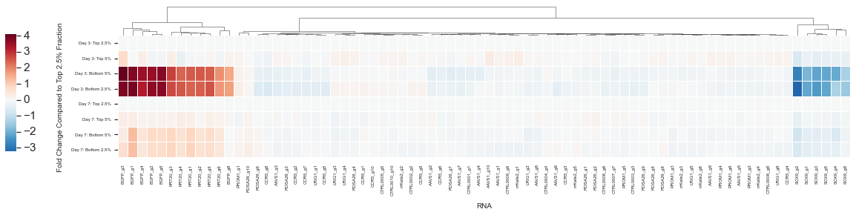
Primer 4
Day 3: Top 2.5%
Day 3: Top 5%
Day 3: Bottom 5%
Day 3: Bottom 2.5%
Day 7: Top 2.5%
Day 7: Top 5%
Day 7: Bottom 5%
Day 7: Bottom 2.5%
Day 3
Day 7
0 features dropped

Slide 20
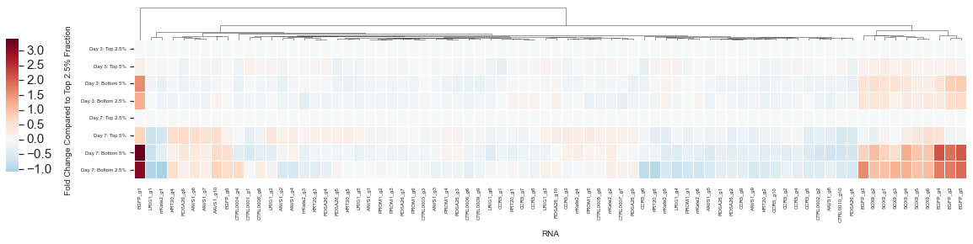
Primer 5
Day 3: Top 2.5%
Day 3: Top 5%
Day 3: Bottom 5%
Day 3: Bottom 2.5%
Day 7: Top 2.5%
Day 7: Top 5%
Day 7: Bottom 5%
Day 7: Bottom 2.5%
Day 3
Day 7
0 features dropped

Slide 21
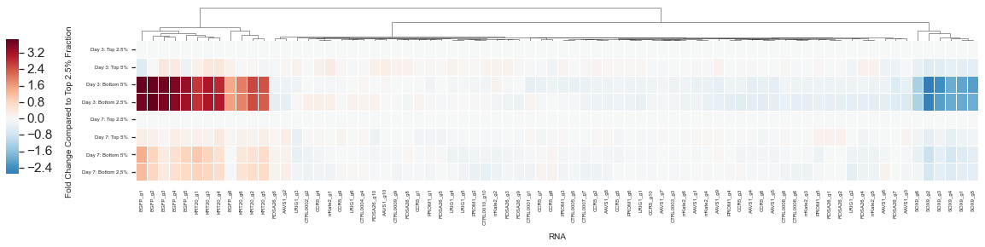
Primer 6
Day 3: Top 2.5%
Day 3: Top 5%
Day 3: Bottom 5%
Day 3: Bottom 2.5%
Day 7: Top 2.5%
Day 7: Top 5%
Day 7: Bottom 5%
Day 7: Bottom 2.5%
Day 3
Day 7
0 features dropped

Slide 22
Primer 1: Regression Analysis, Unsupervised Clustering, and MA Plots

Slide 23
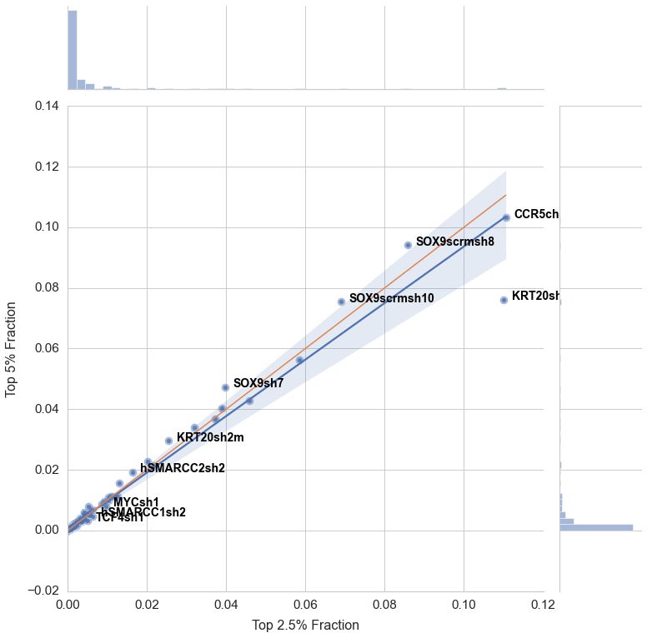
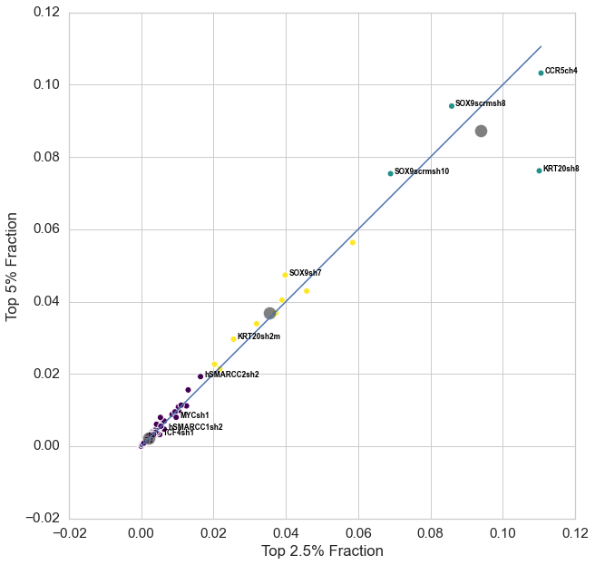
Primer 1: Day 3 (Top 2.5% and Top 5%)

Slide 24
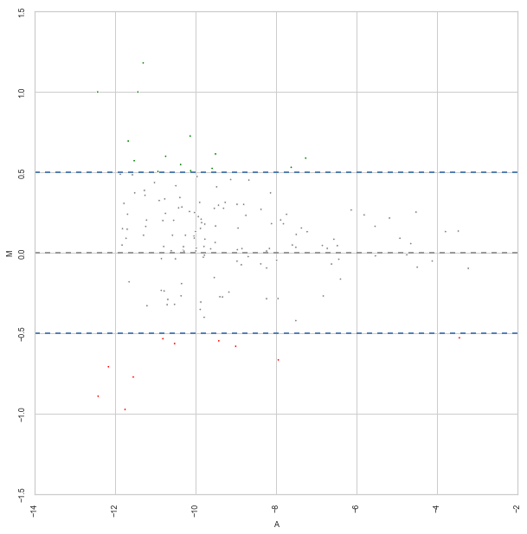
Primer 1: Day 3 (Top 2.5% and Top 5%)

Slide 25
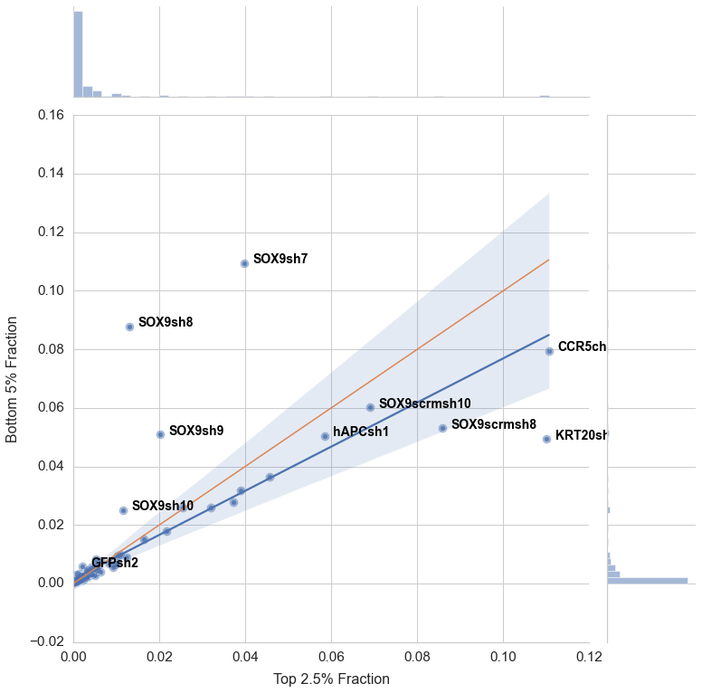
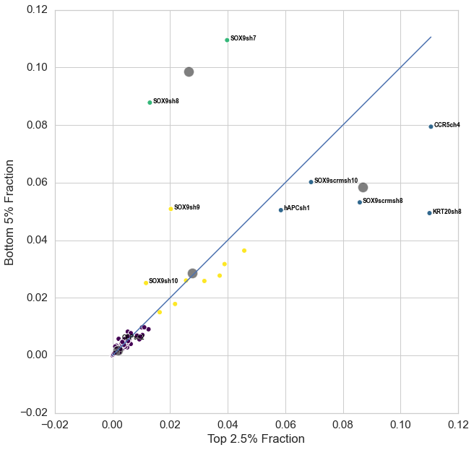
Primer 1: Day 3 (Top 2.5% and Bottom 5%)

Slide 26
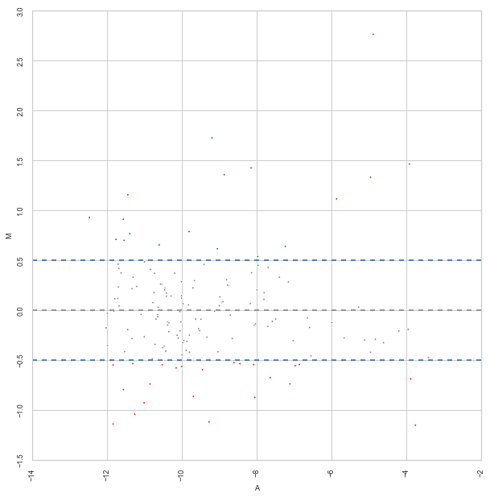
Primer 1: Day 3 (Top 2.5% and Bottom 5%)

Slide 27
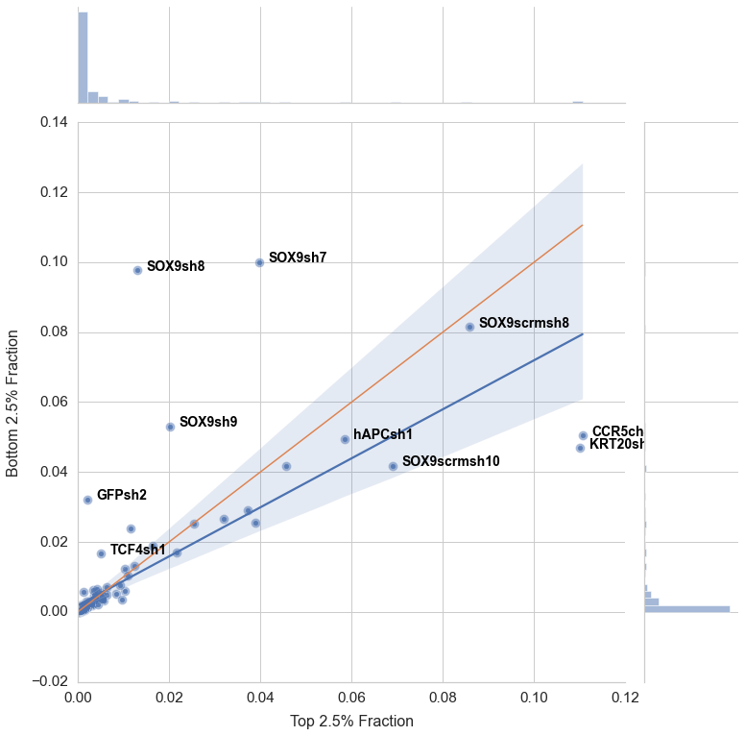
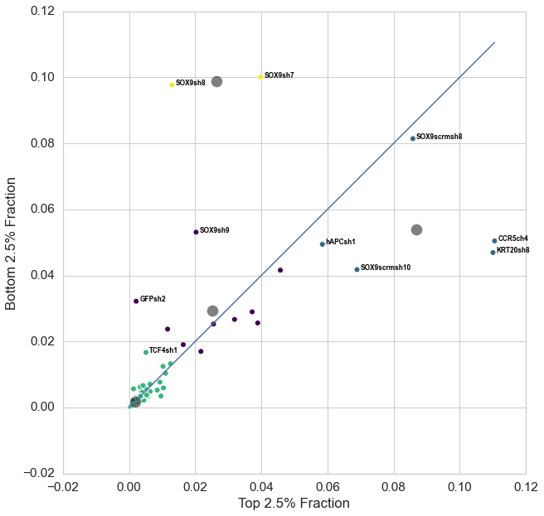
Primer 1: Day 3 (Top 2.5% and Bottom 2.5%)

Slide 28
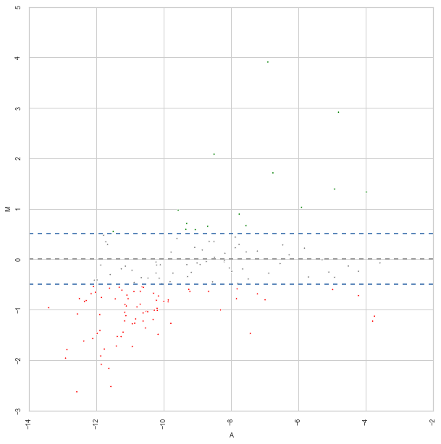
Primer 1: Day 3 (Top 2.5% and Bottom 2.5%)

Slide 29
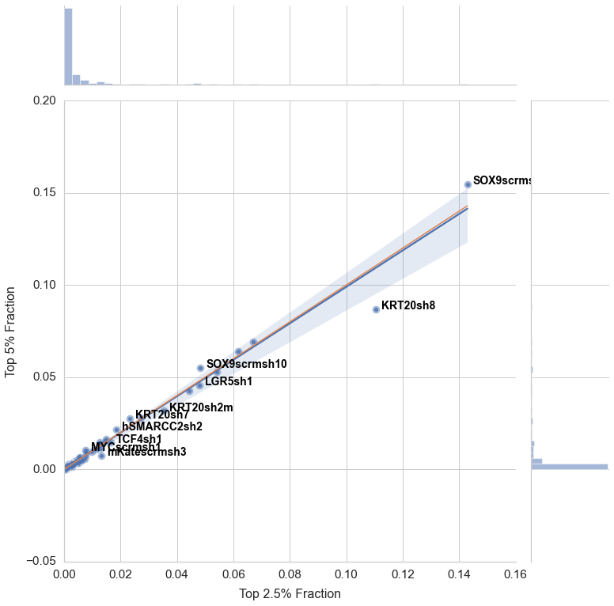
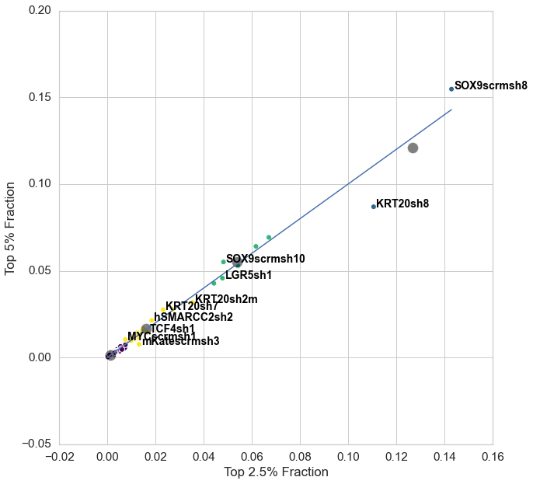
Primer 1: Day 7 (Top 2.5% and Top 5%)

Slide 30
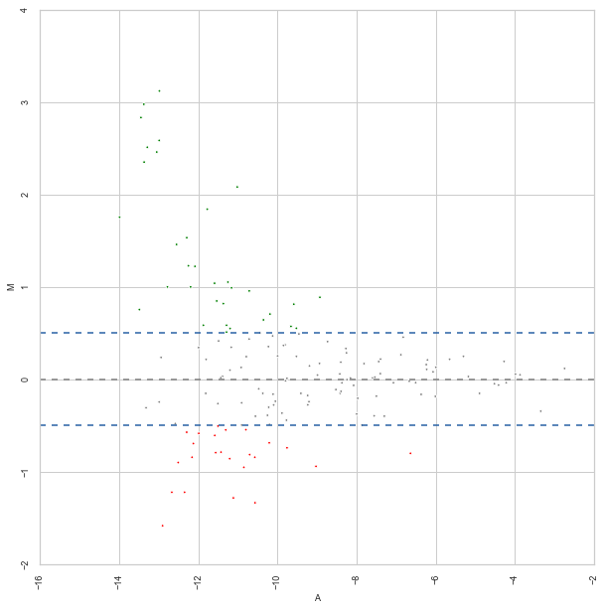
Primer 1: Day 7 (Top 2.5% and Top 5%)

Slide 31
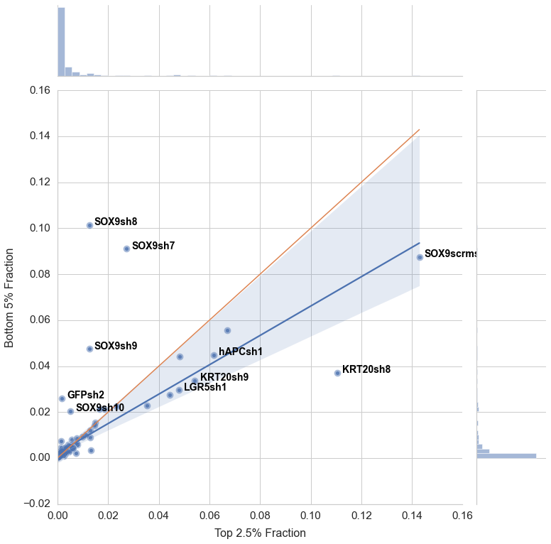
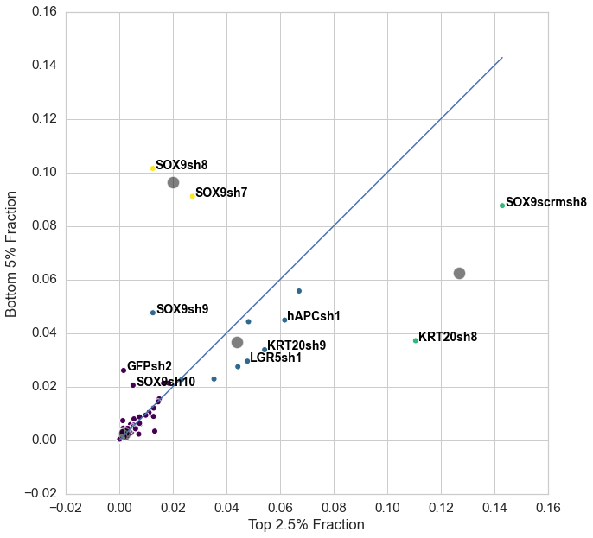
Primer 1: Day 7 (Top 2.5% and Bottom 5%)

Slide 32
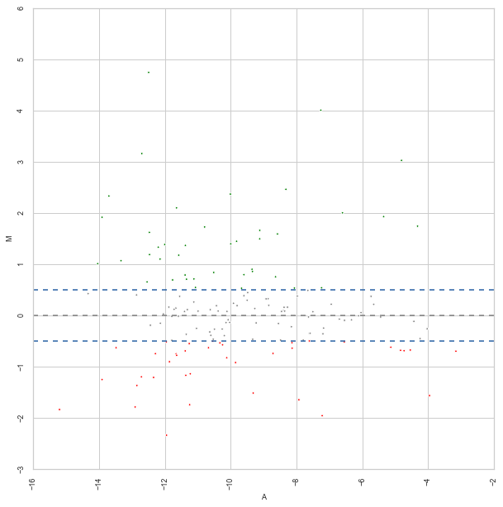
Primer 1: Day 7 (Top 2.5% and Bottom 5%)

Slide 33

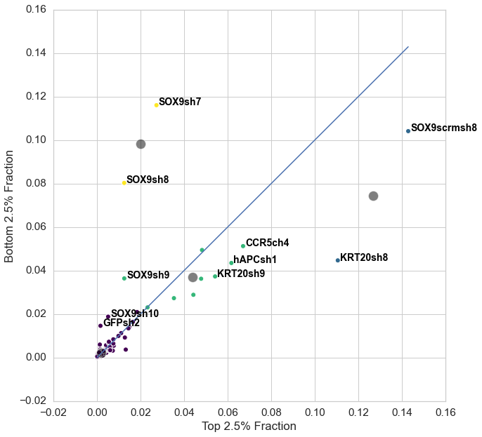
Primer 1: Day 7 (Top 2.5% and Bottom 2.5%)

Slide 34
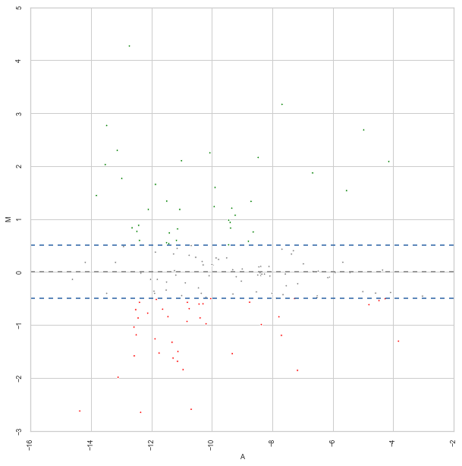
Primer 1: Day 7 (Top 2.5% and Bottom 2.5%)

Slide 35
MaGeCK: Gene Summary Statistics

Slide 36
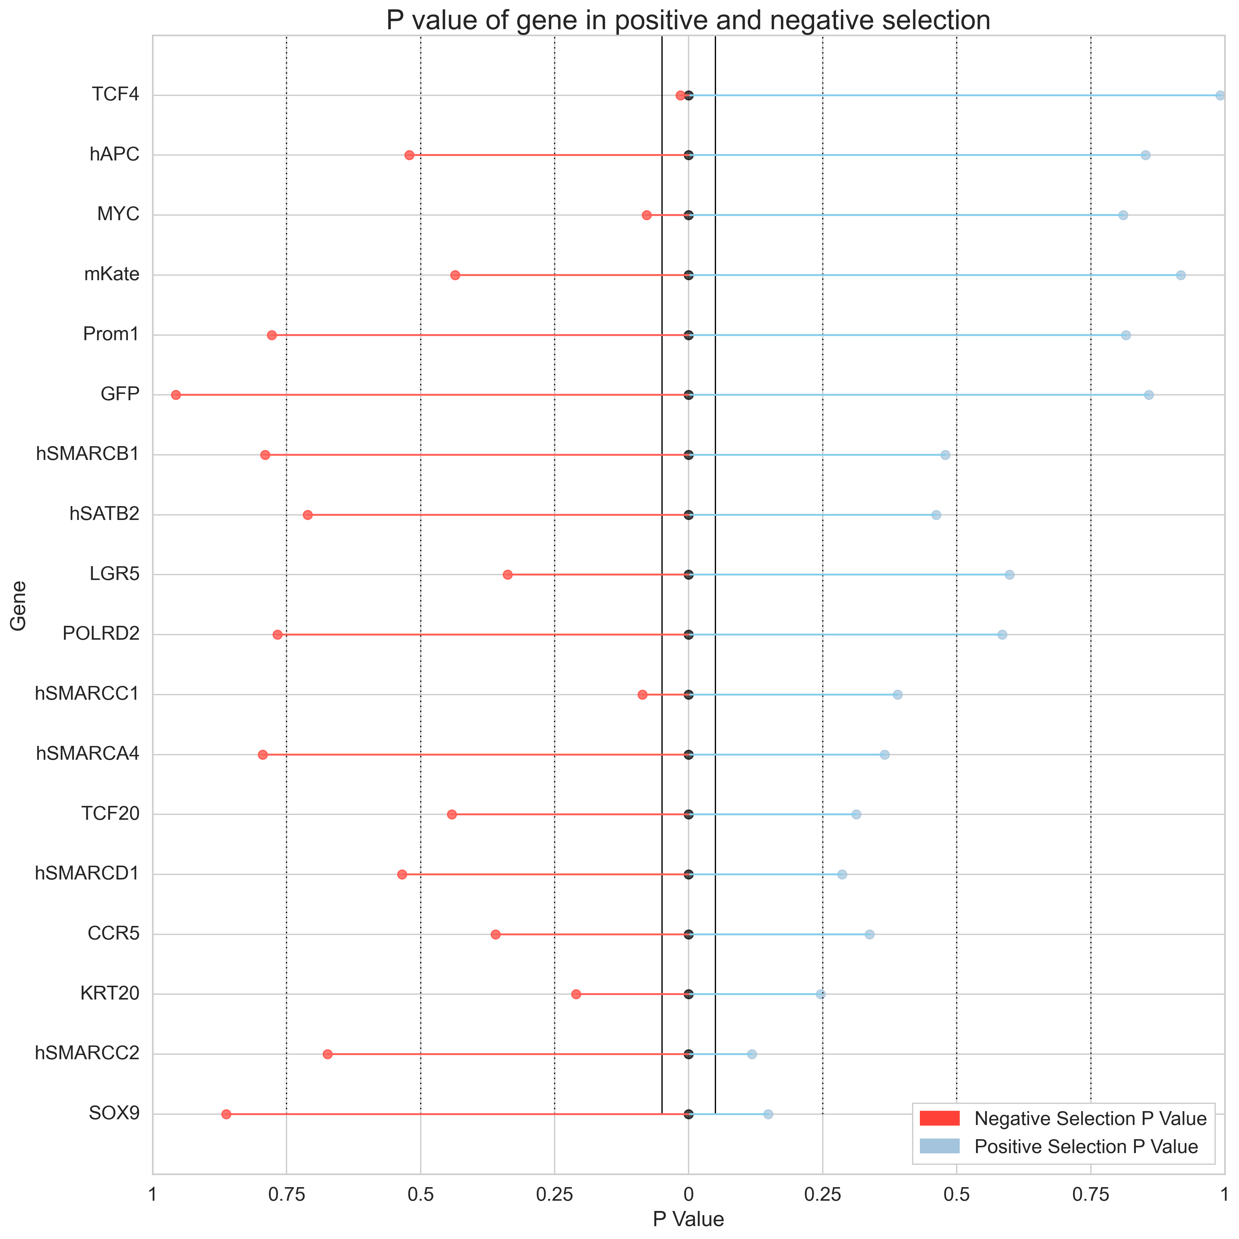
Primer 1: Day 3 (Top 2.5% and Top 5%)

Slide 37
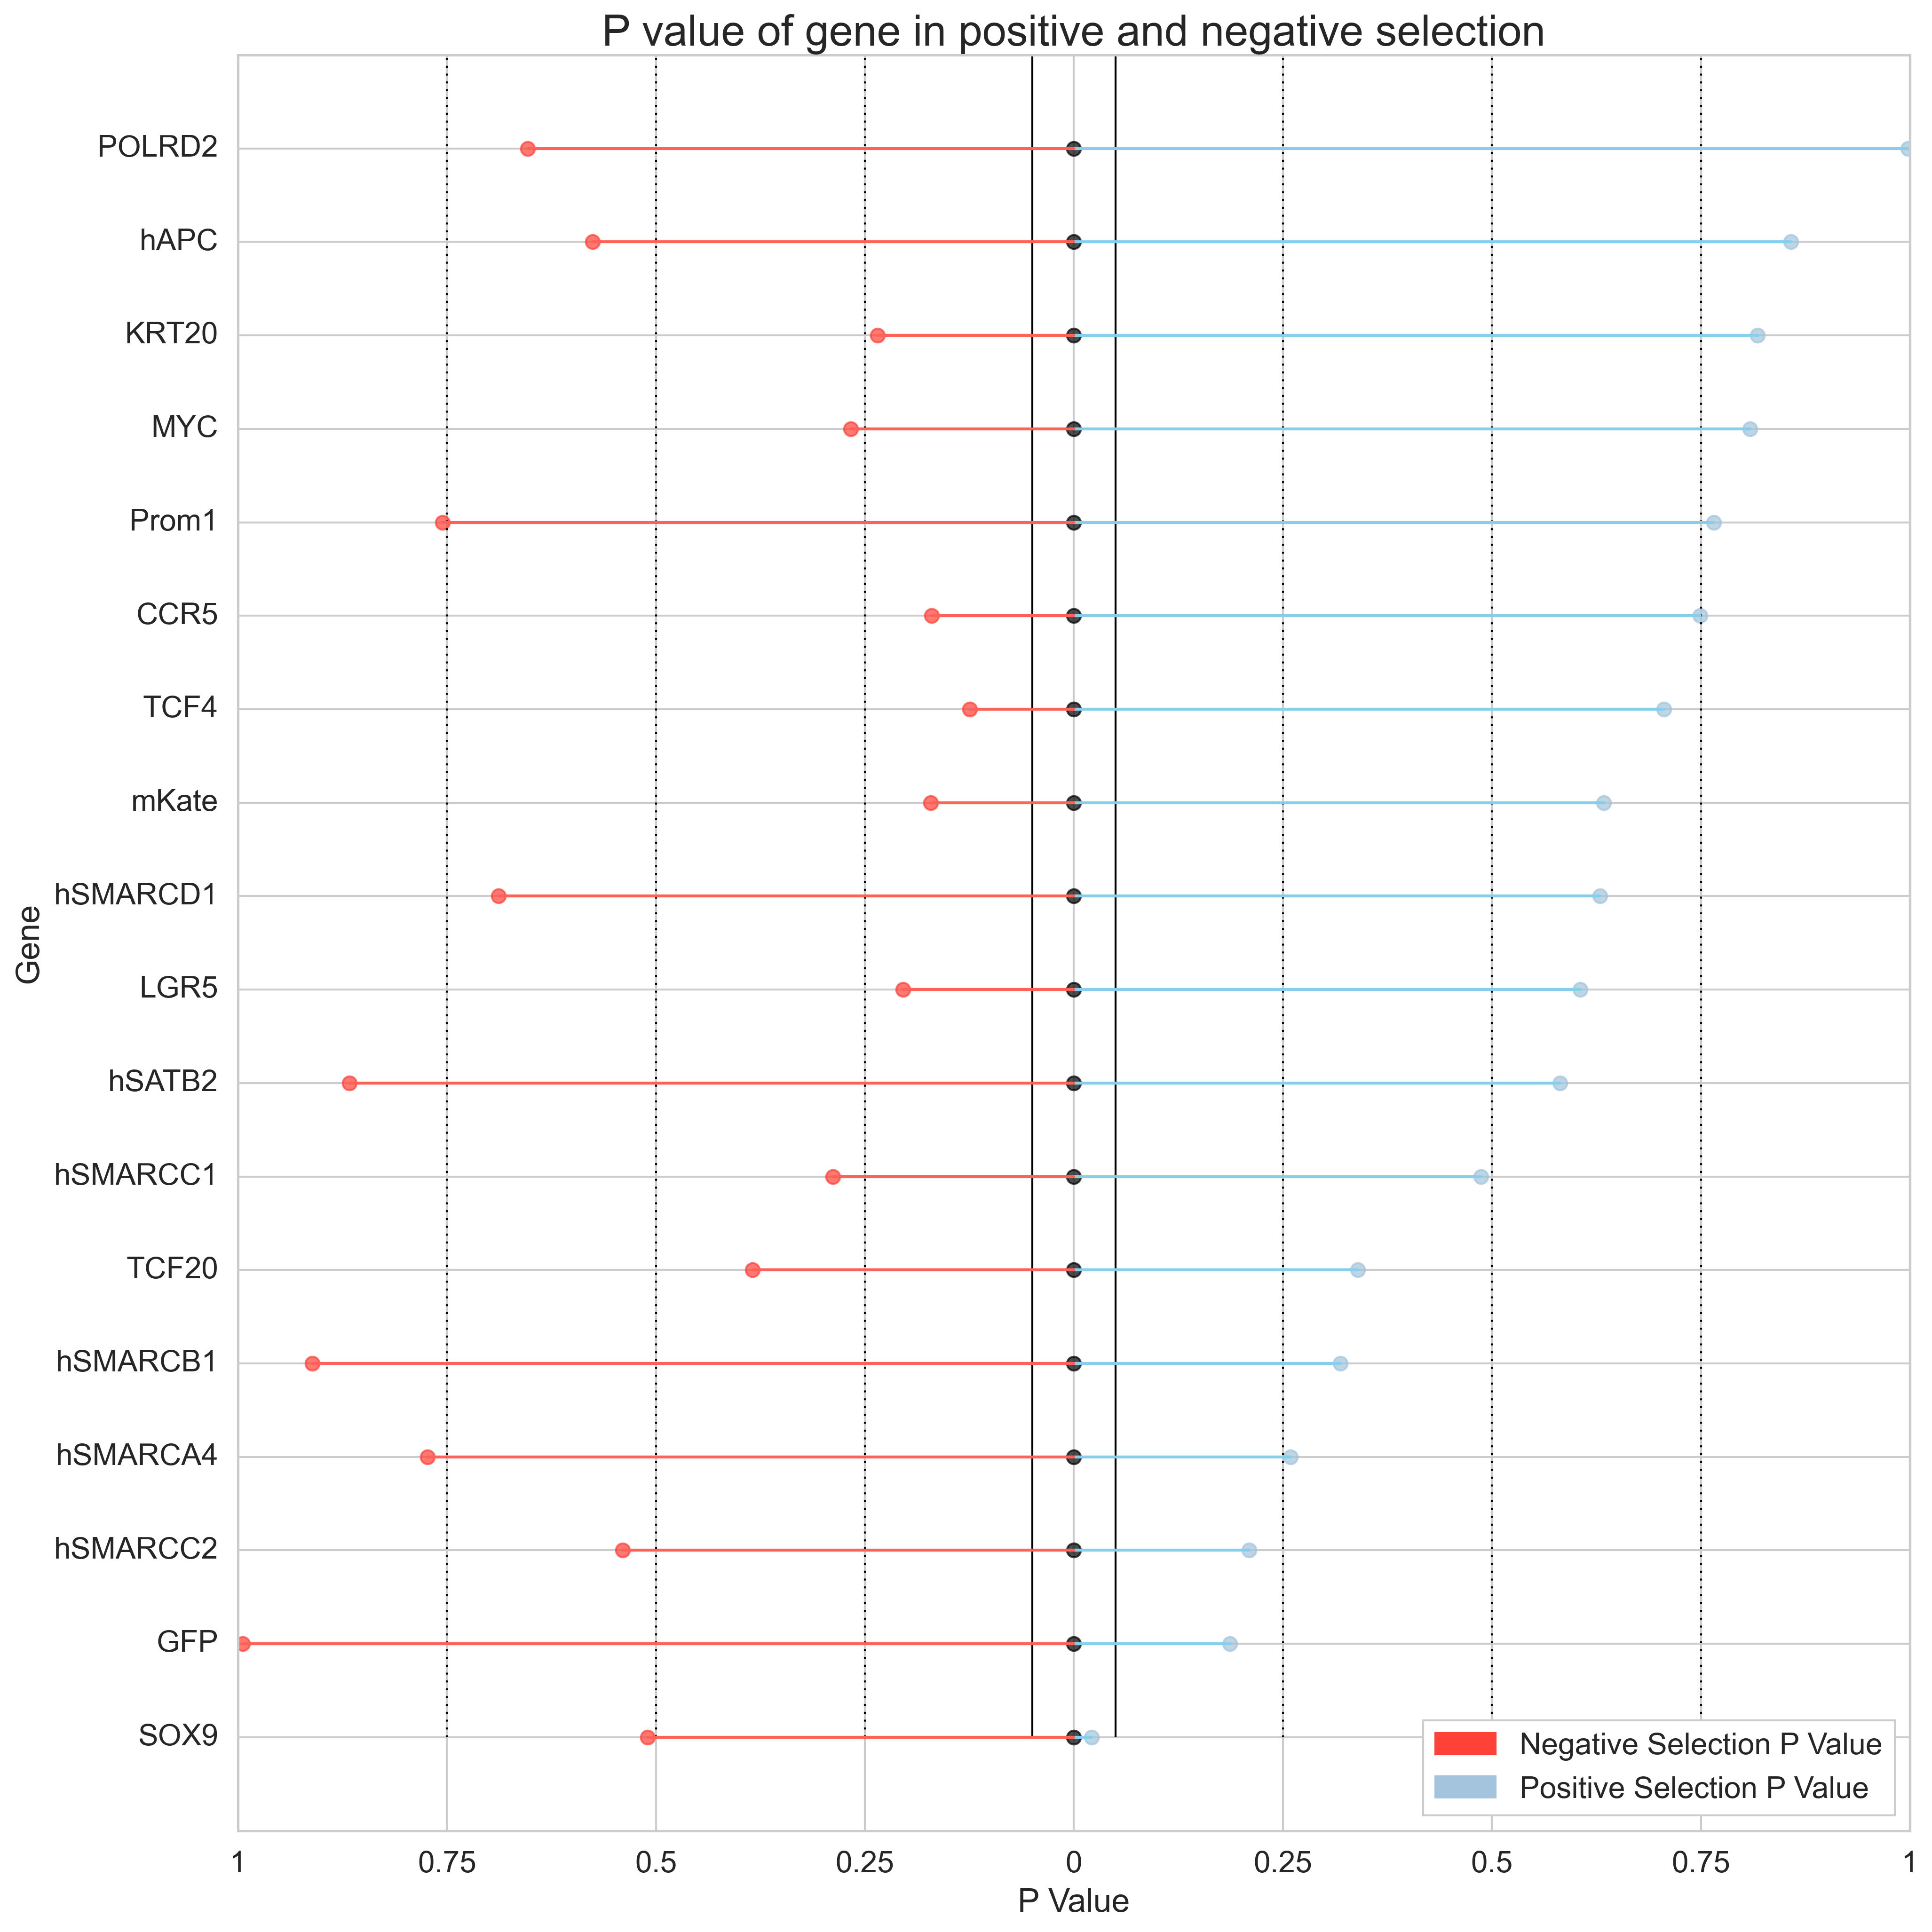
Primer 1: Day 3 (Top 2.5% and Bottom 5%)

Slide 38
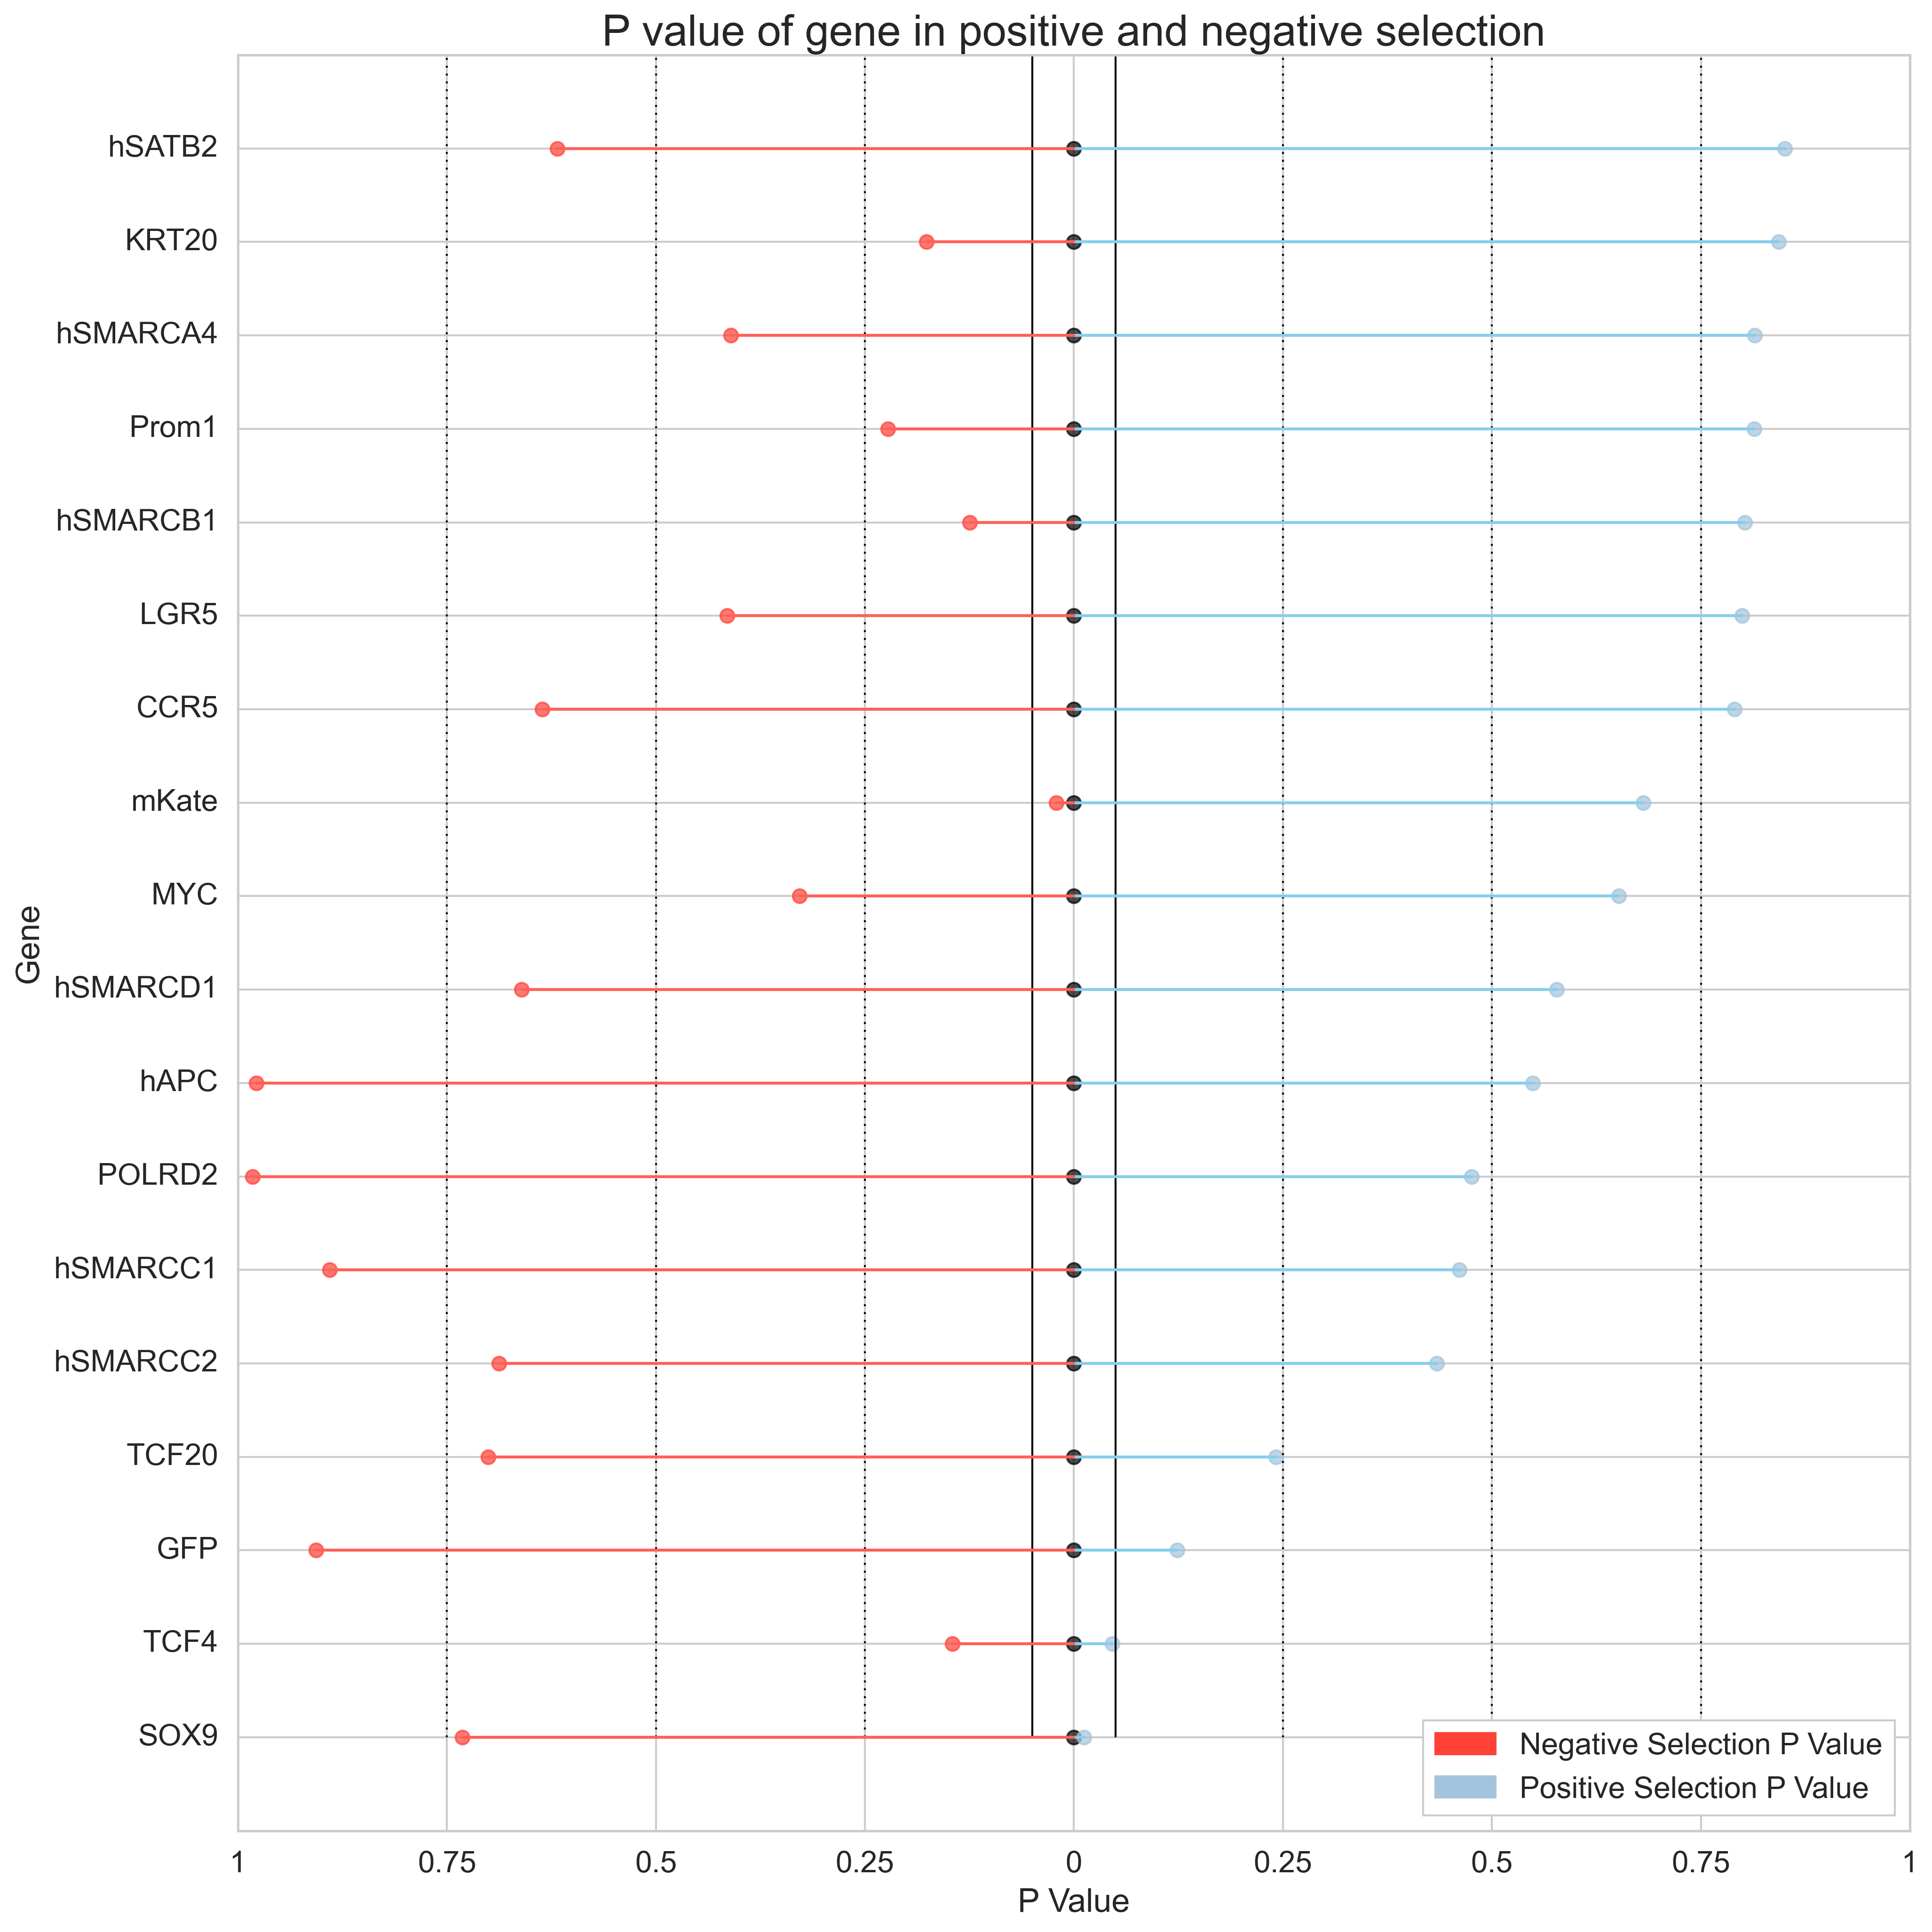
Primer 1: Day 3 (Top 2.5% and Bottom 2.5%)

Slide 39
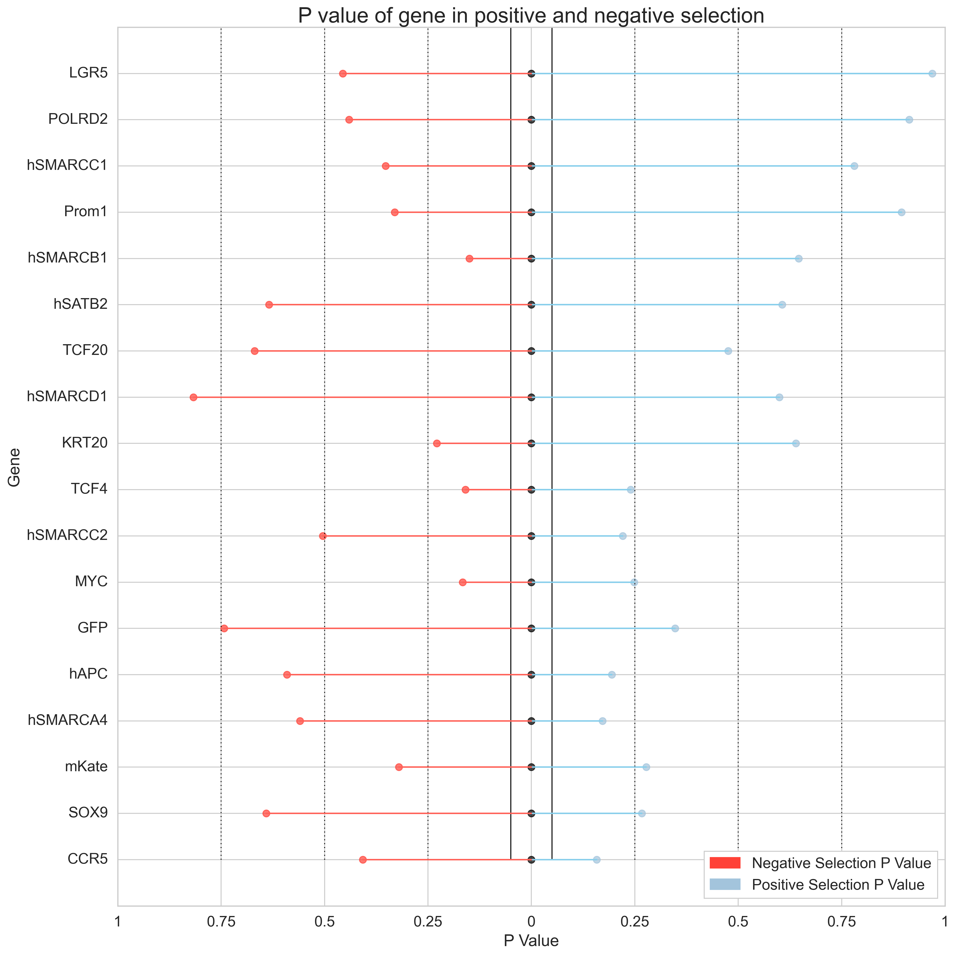
Primer 1: Day 7 (Top 2.5% and Top 5%)

Slide 40
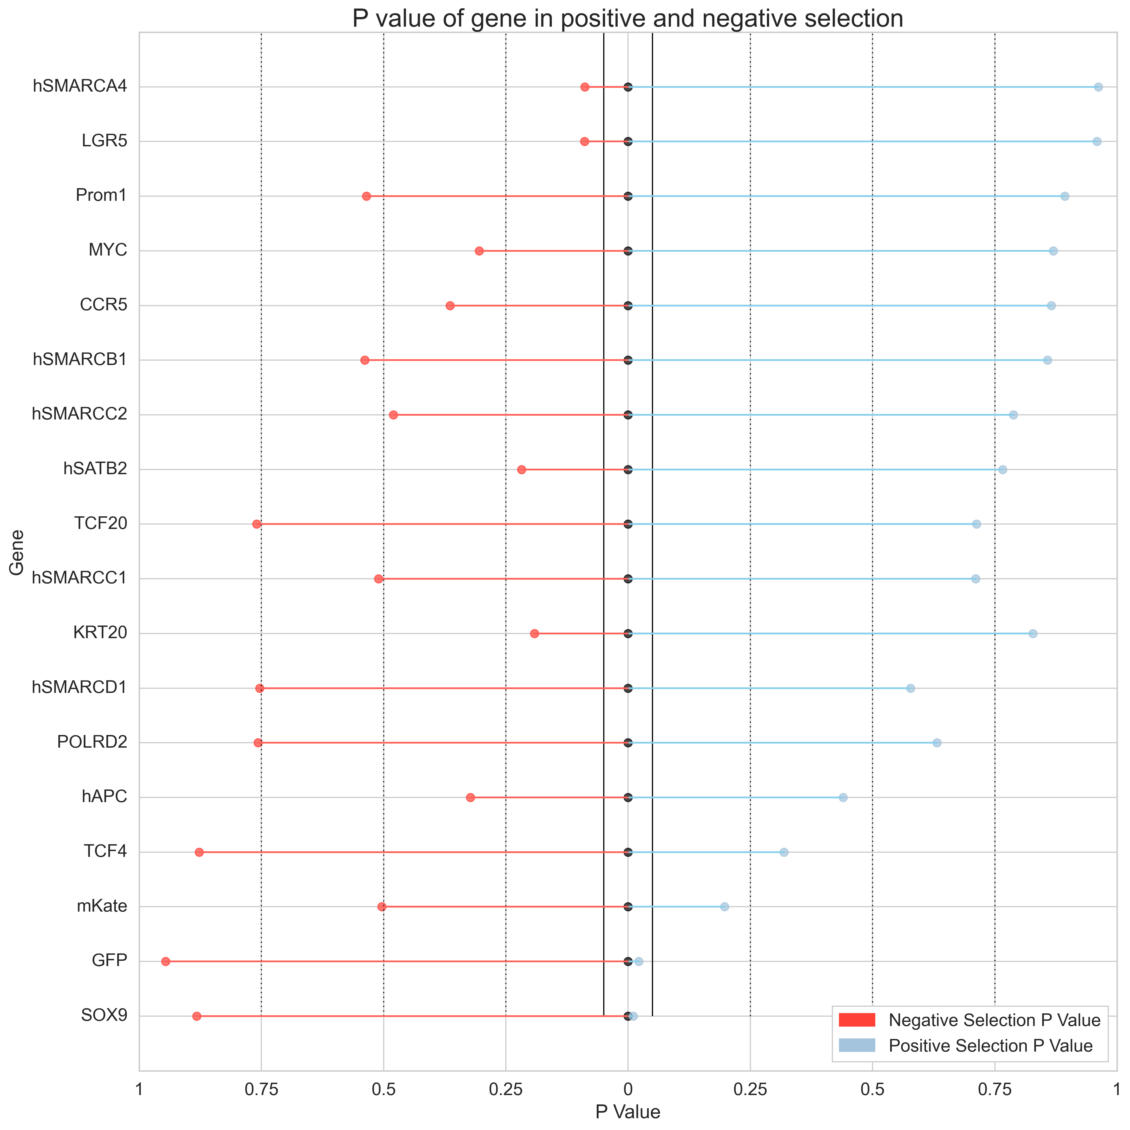
Primer 1: Day 7 (Top 2.5% and Bottom 5%)

Slide 41
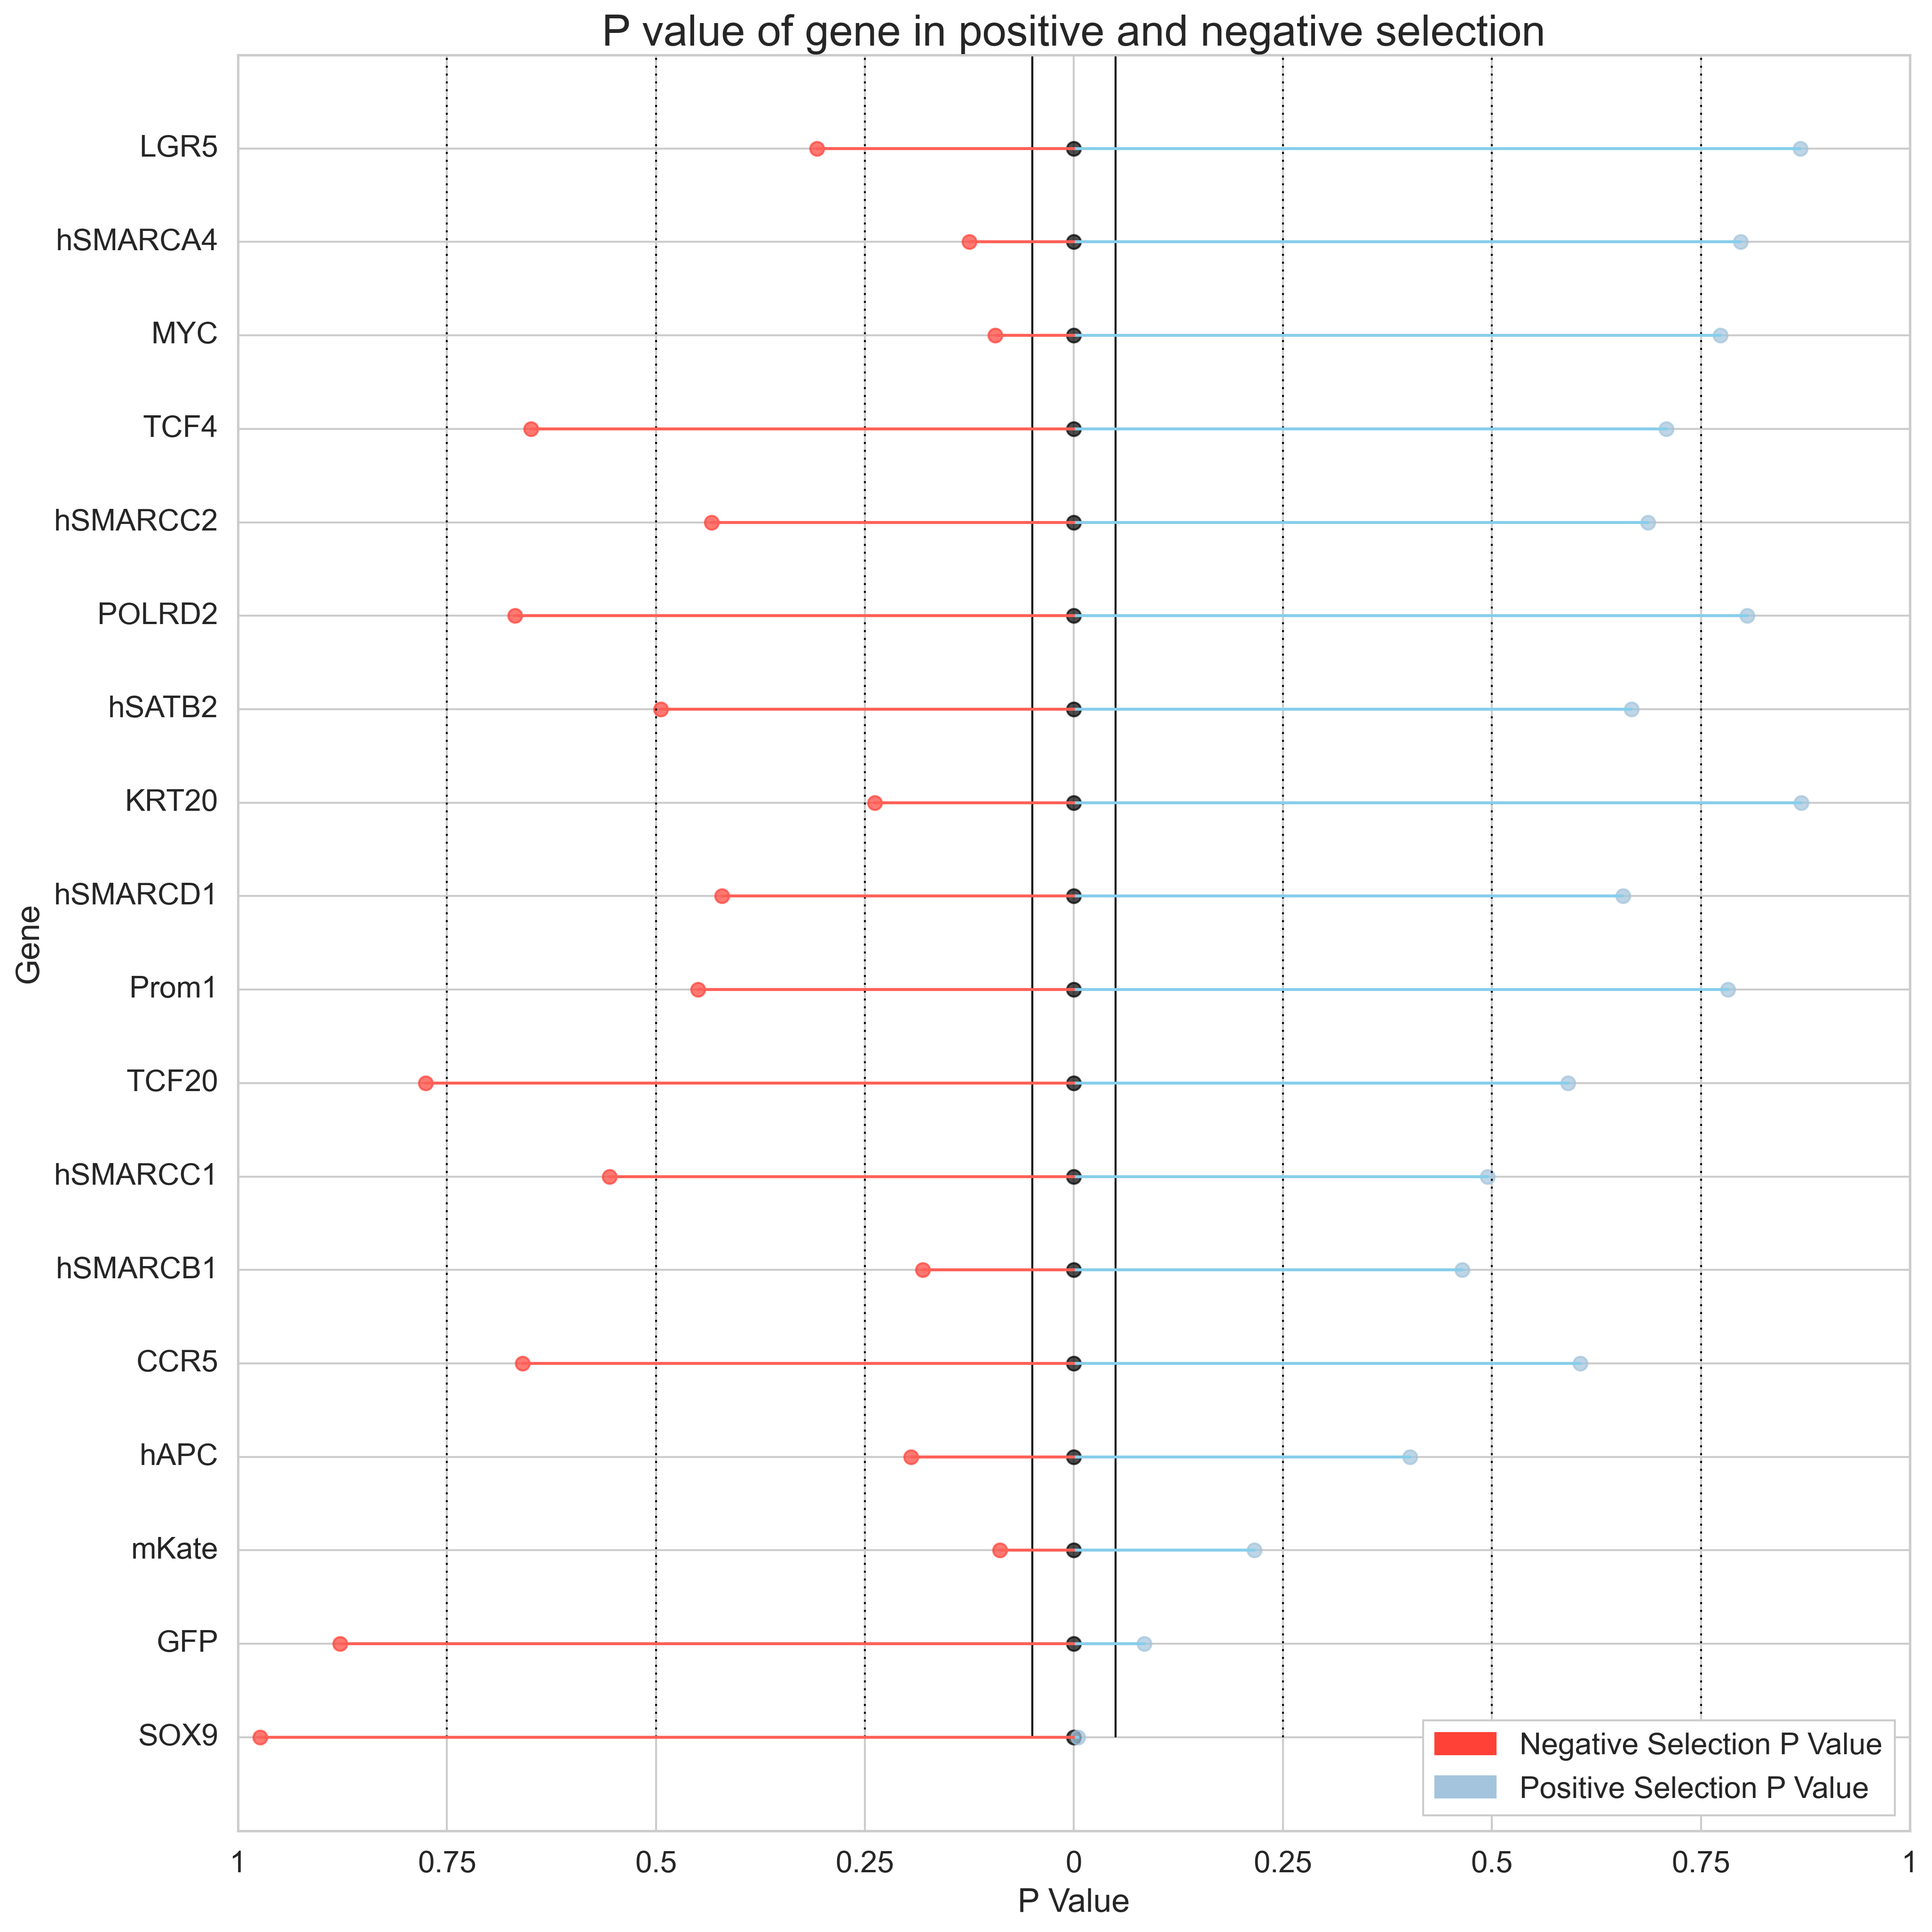
Primer 1: Day 7 (Top 2.5% and Bottom 2.5%)

Slide 42
MaGeCK: RNA Summary Statistics

Slide 43


Primer 1: Day 3 (Top 2.5% and Top 5%)

Slide 44


Primer 1: Day 3 (Top 2.5% and Bottom 5%)

Slide 45


Primer 1: Day 3 (Top 2.5% and Bottom 2.5%)

Slide 46


Primer 1: Day 7 (Top 2.5% and Top 5%)

Slide 47


Primer 1: Day 7 (Top 2.5% and Bottom 5%)

Slide 48


Primer 1: Day 7 (Top 2.5% and Bottom 2.5%)

Slide 49
Conclusion
1. The Day that produced greater average LFC in SOX9 and GFP between each fraction and the Top 2.5% Fraction varies depending on Primer
Refer to bar plots and heatmaps for comparisons of FC between days for each primer
Primer | Day that produced greater LFC in SOX9 and GFP compared to Top 2.5% Fraction
Primer 1 (shrna) | Day 7
Primer 2 (shrna) | Day 3
Primer 3 (sgrna) | Day 7
Primer 4 (sgrna) | Day 3
Primer 5 (sgrna) | Day 7
Primer 6 (sgrna) | Day 3

Slide 50
Conclusion
2. RNA with the greatest FC compared to Top 2.5% Fraction for each primer
Refer to bar plots and heatmaps for comparisons of FC between days for each primer
Primer | RNA | Fraction | Day | Fold Change compared to Top 2.5% Fraction
Primer 1 (shrna) | GFPsh3 | Bottom 5% | 7 | 26.7
 | SOX9sh8 | Bottom 5% | 7 | 8.12
Primer 2 (shrna) | GFPsh3 | Bottom 5% | 3 | 111.6
 | SOX9sh2 | Bottom 5% | 3 | 20.40
Primer 3 (sgrna) | EGFP_g2 | Top 5% | 7 | 48.77
 | SOX9_g2 | Bottom 2.5% | 7 | 2.59
Primer 4 (sgrna) | EGFP_g3 | Bottom 5% | 3 | 17.15
 | SOX9_g6 | Top 5% | 7 | 0.94
Primer 5 (sgrna) | EGFP_g1 | Bottom 5% | 7 | 10.54
 | SOX9_g4 | Bottom 5% | 7 | 2.38
Primer 6 (sgrna) | EGFP_g1 | Bottom 5% | 3 | 14.57
 | SOX9_g6 | Bottom 2.5% | 7 | 0.94

Slide 51
Conclusion
3. Day 7 tends to upregulate FC compared to Top 2.5% Fraction on average compared to Day 3 for Primer 1
Top 5%
Bottom 5%
Bottom 2.5%
Day 3
Day 7

Slide 52
Conclusion
4. Bottom 2.5% Fraction compared to Top 2.5% Fraction produces the most prominent average LFC in Day 3, with a lesser effect shown on Day 7
Top 5%
Bottom 5%
Bottom 2.5%
Day 3
Day 7

Slide 53
Conclusion
5. Comparing Bottom 5% to Top 2.5% on Day 7 and Bottom 2.5% to Top 2.5% on Day 3 produced significant P value for positive selection of the GFP and/or SOX9 genes
Day 3: Bottom 2.5%
Day 7: Bottom 5%

Slide 54
Conclusion
6. Comparing Bottom 2.5% Fraction to
Top 2.5% Fraction for Primer 1 yielded
the greatest number of SOX9 and GFP RNA
that had an Upper P value tail < 0.05

